Slide 1
Social Influence and Persuasion
Donna Vandergrift, Associate Professor, Psychology
www.donnavandergrift.com
dvandergrift@bcc.edu
Welcome Back Spring 2016

Slide 2
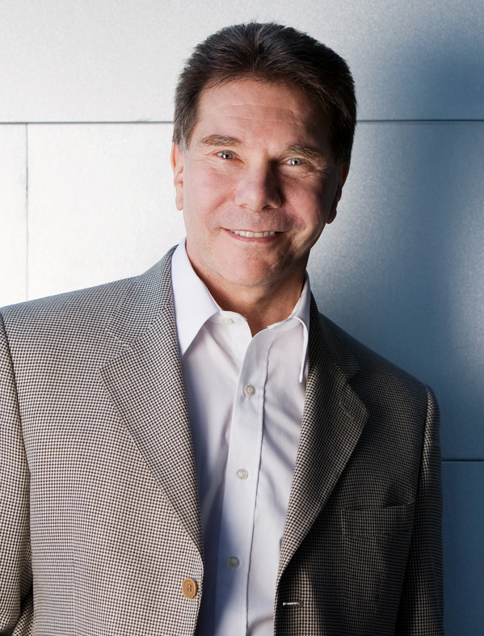
Social Influence and Persuasion
Convincing others to behave the way you want them to can be difficult, but by understanding some psychology principles can help you be more effective.
Robert Cialdini’s (1984, 2001)
scientific research of persuasion.

Slide 3
Social Influence Principles
Reciprocity
Commitment & Consistency
Social proof
Authority
Likeability
Scarcity

Slide 4
Social Influence Principles
Reciprocity: We want to repay, in kind, what another person has provided us.
Commitment & Consistency
Social proof
Authority
Likeability
Scarcity

Slide 5
Techniques of Social Influence: based on principles of reciprocity
Social Norm of Reciprocity
Humans have a inborn tendency to reciprocate.
Research/Examples
Restaurant servers: Give two candies to customers = 14.1% increase in tips.
Reuse towels (Hotels): Money already given to charity = 26% reuse.
Free gifts, “just for you”, kindness, etc.

Slide 6
Techniques of Social Influence: based on principles of reciprocity
Door-in-the-Face Technique
Start with an inflated request and then retreat to a smaller one that appears to be a concession
Does not work if the first request is viewed as unreasonable or if requests are made by different people
That’s-Not-All Technique
Begin with inflated request but immediately add to the deal by offering a bonus or discount

Slide 7
Social Influence Principles
Reciprocity: We want to repay, in kind, what another person has provided us.
Commitment & Consistency: Desire to be (and to appear) consistent with what we have already done.
Social proof
Authority
Likeability
Scarcity

Slide 8
Techniques of Social Influence: based on principles of commitment and consistency
Theories/Research
Cognitive Dissonance
Unpleasant state when attitude and behavior are inconsistent.
Festinger & Carlson (1959)
Asked participants to perform a series of dull tasks (such as turning pegs in a peg board for an hour). Afterwards, the participant's attitudes toward this task were highly negative. They were then paid either $1 or $20 to tell a waiting participant (relay a confederate) that the tasks were really interesting.
Who changed their attitude about the task?
Notes:
Teaching Tip: Robert Cialdini’s book Influence: Science and Practice presents numerous examples of social influence that you can use with your class (http://changingminds.org/explanations/theories/informational_social_influence.htm).
Technology Tip: A very interesting glimpse inside the mind of someone recruited into a cult-like self-help group is available at CityPages.
Technology Tip: A PBS Frontline episode on marketing is available in its entirety at PBS.org, which also offers discussion groups, interviews, and teacher guides (http://www.pbs.org/wgbh/pages/frontline/shows/persuaders/view/).
Technology Tips: Steve Booth-Butterfield provides examples of the foot-in-the-door and door-in-the-face techniques on his website (http://www.as.wvu.edu/~sbb/comm221/chapters/twosteps.htm).
Technology Tip: A current car financing scam called yo-yo financing is a variation on the low-ball technique. See, for example, the article “Yo-Yo Deals: Stringing Car Buyers Along” at Washingtonpost.com.

Slide 9
Techniques of Social Influence: based on principles of commitment and consistency
Theories/Research
Effort Justification
After putting in a lot of effort, people will attribute greater value to it.
Aronson & Mills, 1959: People seek to justify and rationalize any suffering or effort they have made.
Self Perception Theory
People infer their own attitudes, opinions, and other internal states partly by observing their past behavior.
Notes:
Teaching Tip: Robert Cialdini’s book Influence: Science and Practice presents numerous examples of social influence that you can use with your class (http://changingminds.org/explanations/theories/informational_social_influence.htm).
Technology Tip: A very interesting glimpse inside the mind of someone recruited into a cult-like self-help group is available at CityPages.
Technology Tip: A PBS Frontline episode on marketing is available in its entirety at PBS.org, which also offers discussion groups, interviews, and teacher guides (http://www.pbs.org/wgbh/pages/frontline/shows/persuaders/view/).
Technology Tips: Steve Booth-Butterfield provides examples of the foot-in-the-door and door-in-the-face techniques on his website (http://www.as.wvu.edu/~sbb/comm221/chapters/twosteps.htm).
Technology Tip: A current car financing scam called yo-yo financing is a variation on the low-ball technique. See, for example, the article “Yo-Yo Deals: Stringing Car Buyers Along” at Washingtonpost.com.

Slide 10
Techniques of Social Influence: based on principles of commitment and consistency
Foot-in-the-Door Technique
Start with small request to gain eventual compliance with larger request.
Low-ball Technique
Start with low-cost request and later reveal the hidden costs.
Notes:
Teaching Tip: Robert Cialdini’s book Influence: Science and Practice presents numerous examples of social influence that you can use with your class (http://changingminds.org/explanations/theories/informational_social_influence.htm).
Technology Tip: A very interesting glimpse inside the mind of someone recruited into a cult-like self-help group is available at CityPages.
Technology Tip: A PBS Frontline episode on marketing is available in its entirety at PBS.org, which also offers discussion groups, interviews, and teacher guides (http://www.pbs.org/wgbh/pages/frontline/shows/persuaders/view/).
Technology Tips: Steve Booth-Butterfield provides examples of the foot-in-the-door and door-in-the-face techniques on his website (http://www.as.wvu.edu/~sbb/comm221/chapters/twosteps.htm).
Technology Tip: A current car financing scam called yo-yo financing is a variation on the low-ball technique. See, for example, the article “Yo-Yo Deals: Stringing Car Buyers Along” at Washingtonpost.com.

Slide 11
Techniques of Social Influence: based on principles of commitment and consistency
Bait-and-Switch Technique
Draw people in with an attractive offer that is not available and then switch to a less attractive offer that is available.
Labeling Technique
Assigning a label to an individual and then making a request consistent with that label
Self-Fulfilling prophesy.

Slide 12
Techniques of Social Influence: based on principles of commitment and consistency
All of these relate to various theories:
Cognitive Dissonance
Effort Justification
Self-Perception
We have made a commitment in some way and we want to maintain a perception of consistency about ourselves.
Notes:
12

Slide 13
Social Influence Principles
Reciprocity: We want to repay, in kind, what another person has provided us.
Commitment & Consistency: Desire to be (and to appear) consistent with what we have already done.
Social proof: To determine what is correct, we find out what other people think is correct.
Authority
Likeability
Scarcity

Slide 14
Techniques of Social Influence: based on principles of social proof
The greater number of people who find an idea correct, the more the idea will be correct.
When we are unsure of ourselves, when the situation is unclear, when uncertainty reigns, we are most likely to look and accept the actions of others as correct.
Pluralistic ignorance: everyone is looking to see what everyone else is doing.
Similarity: social proof operates most powerfully when we observe people just like us.
Notes:
14

Slide 15
Techniques of Social Influence: based on principles of social proof
Pluralistic Ignorance: Catherine Genovese’s murder
Failure of bystanders to aid a victim
Better chance of receiving aid if there is only 1 bystander?
Observational Learning
Children dog phobia
Took children who were fearful of dogs, had them watch other children play happily with dogs for twenty minutes each day. Saw drastic improvement after only four days. 67% of fearful children were now willing to go play with the dogs after watching the other children.
We are more influenced by seeing people’s behaviors.
Notes:
15

Slide 16
Techniques of Social Influence: based on principles of social proof
Laugh and applause tracks; movie is funnier when watching with others.
Bartenders “salt” their tip jars.
Research showed that about 40% of guests reused their towels at least once. Cialdini tested Social Proof influence by changing the message on the cards from focusing on the environmental benefits of reuse to ‘The majority of guests who stay in our hotel reuse their towels’. An additional 26% of guests reused towels in response to the revised message.
Notes:
16

Slide 17
Social Influence Principles
Reciprocity: We want to repay, in kind, what another person has provided us.
Commitment & Consistency: Desire to be (and to appear) consistent with what we have already done.
Social proof: To determine what is correct, we find out what other people think is correct.
Authority: Deep-seated sense of duty to authority.
Likeability
Scarcity

Slide 18
Techniques of Social Influence: based on principles of authority
People respect authority. They want to follow the lead of real experts. Business titles, impressive clothing, and even driving an expensive, high-performing automobile are proven factors in lending credibility to any individual.
Giving the appearance of authority actually increases the likelihood that others will comply with requests – even if their authority is illegitimate.
Notes:
18

Slide 19
Techniques of Social Influence: based on principles of authority
Stanley Milgram’s (1974) Authority Experiment
Ordinary people were asked to shock ‘victims’ when they answered questions incorrectly. Those in charge were dressed in white lab coats to give the appearance of high authority. The participants were told that the shocks they gave increased 15 volts in intensity each time the person answered incorrectly.
Notes:
19

Slide 20
Social Influence Principles
Reciprocity: We want to repay, in kind, what another person has provided us.
Commitment & Consistency: Desire to be (and to appear) consistent with what we have already done.
Social proof: To determine what is correct, we find out what other people think is correct.
Authority: Deep-seated sense of duty to authority.
Likeability: We are more say yes to someone we like.
Scarcity

Slide 21
Techniques of Social Influence: based on principles of likability
We are more likely to say yes to someone we like or know.
Let's throw a Tupperware party“
What can I do? It's for one of my friends“
The Shaklee Corporation
The mere mention of a familiar friend
Social scientists have identified a number of factors that cause liking.
Physical AttractivenessAttractiveness has an advantageThe "Halo Effect"Assigning favorable traitsVoters and handsome politiciansSimilarityWe like people who are similar to usSimilarity can be based on any figure1970s: dimes and street clothes ComplimentsWe like those who provide praiseJoe Girard, "I like you""We are suckers for flattery"
Notes:
21

Slide 22
Techniques of Social Influence: based on principles of likability
Physical Attractiveness
Attractiveness has an advantage.
The "Halo Effect“
Assigning favorable traits
Similarity
We like people who are similar to us.
Compliments
We like those who provide praise.
Familiarity
Mere exposure effect
Association
Conditioning
Notes:
22

Slide 23
Social Influence Principles
Reciprocity: We want to repay, in kind, what another person has provided us.
Commitment & Consistency: Desire to be (and to appear) consistent with what we have already done.
Social proof: To determine what is correct, we find out what other people think is correct.
Authority: Deep-seated sense of duty to authority.
Likeability: We are more likely say yes to someone we like.
Scarcity: Limitation enhances desirability.

Slide 24
Techniques of Social Influence: based on principles of scarcity
Rare opportunities are more valuable than plentiful ones
Limited-Number Technique
Fast-Approaching Deadline Technique
Scarcity heuristic in decision making
What is rare is good.
Psychological reactance
When personal freedoms are threatened, we experience an unpleasant emotional response.
As opportunities become less available, we loose freedoms; and we hate to loose freedoms.

Slide 25
Social Influence Principles
Reciprocity: We want to repay, in kind, what another person has provided us.
Commitment & Consistency: Desire to be (and to appear) consistent with what we have already done.
Social proof: To determine what is correct, we find out what other people think is correct.
Authority: Deep-seated sense of duty to authority.
Likeability: We are more likely say yes to someone we like.
Scarcity: Limitation enhances desirability.

Slide 26
Defenses Against Techniques
Reciprocation
Evaluate favors or concessions to avoid guilt over lack of reciprocity
Commitment and Consistency
Reexamine the sense of obligation
Social Proof
Recognize ‘fake’ social proofs
Scarcity
Recognize psychological reactance as a signal to think rationally
Evaluate the reason we want the item

Slide 27
What Can We Do?
Reciprocity
Commitment & Consistency
Social proof
Authority
Likeability
Scarcity

