Slide 1
Chapter 1 Perspectives on Sexuality

Slide 2
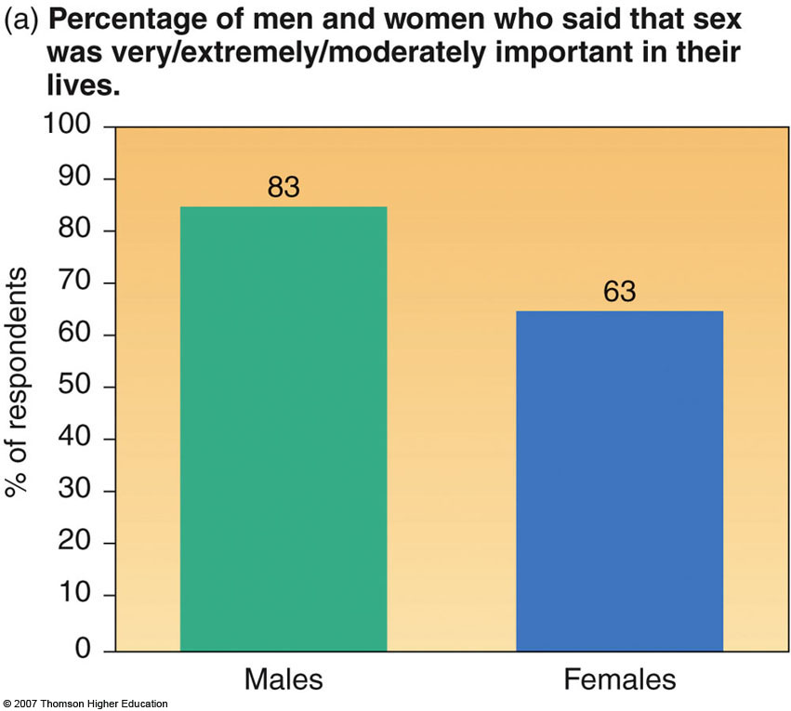
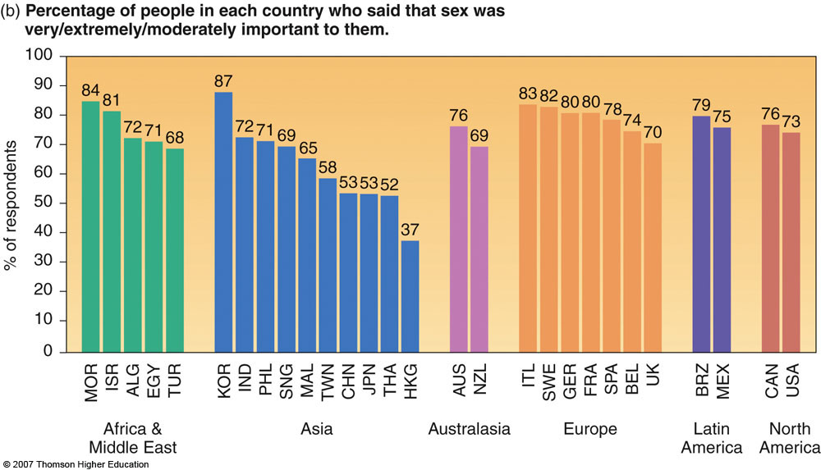
Sexuality
Why study sexuality?
How much do you know about human sexuality?
Notes:
Help students see how taking this course can help them make important life decisions.
Make sure to point out that being sexually active is not part of sexual intelligence.

Slide 3
Sexual Intelligence
Four components of sexual intelligence
Understanding self
Having interpersonal sexual skills and integrity
Obtaining accurate scientific sexual knowledge
Having consideration of the cultural context of sexuality
Increasing sexual intelligence will allow for responsible decisions in sexual behavior
Notes:
Help students see how taking this course can help them make important life decisions.
Make sure to point out that being sexually active is not part of sexual intelligence.

Slide 4
Studying Sexuality: From a Psychosocial Orientation
A psychosocial orientation takes into account
Psychological factors
- Emotions, attitudes, motivations
Social conditioning factors
- Process with which we learn our social norms
Biological factors
- Hormones, nervous system, genetics, etc.

Slide 5
Controversy and Diversity in Human Sexuality
Why do the authors attempt to bring an inclusive approach to Our Sexuality?
What factors contribute to diversity and similarity of sexual attitudes and behaviors within the United States?
Notes:
Hold discussion on various factors from our world that have an affect on our perspective of sexuality. This also helps students begin to see that everyone has a different perspective on sexuality due to the diversity of influences among them.

Slide 6
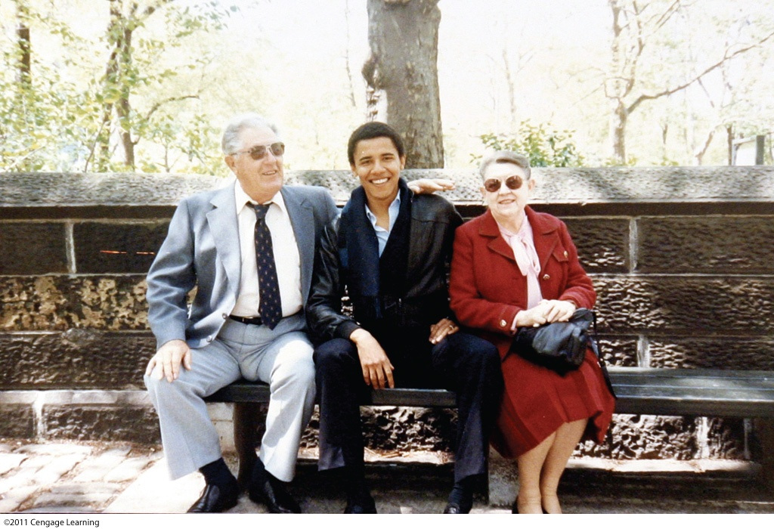
Diversity in the United States

Slide 7
Cross-Cultural Perspectives Islamic Middle East
Based on beliefs of Muhammad
Belief that sex should be enjoyed by both sexes
Women viewed inherently more sexual than men (this power contained by veils, segregation, female circumcision)
Oppression of women and many sexually related restrictions stem from patriarchal cultural traditions and fundamentalist sects, not from religion and the teaching of the Qur’an

Slide 8
Cross-Cultural Perspectives China
Ancient China
Produced the earliest known sex manuals
Under Taoism, sexual activity was promoted for spiritual growth and harmony
The sexual connection of men and women was believed to join the opposing forces of yin and yang

Slide 9
Cross-Cultural Perspectives China
Sexual conservatism with communist rule (1949)
Lack of basic information about sexuality
Sex outside of marriage and frequent sex within marriage discouraged
Almost no STDs
Current trends
Increasing rates of premarital sex
Increasing rates of HIV infection
Slightly more open to homosexuality
Still lack sexual knowledge and safe-sex skills

Slide 10
Our Cultural Legacy Two Themes
Sex for procreation
Definition of sex and intercourse used synonymously
Male and female gender roles
What importance do the historical themes of sex for procreation and male/female gender roles have today?
Notes:
Discussion on how we “define” sex and key points in history that were pivotal to this. How clearly do we define male/female gender roles currently? Rigid gender-role conditioning can limit each person’s potential and can harm their sexuality.

Slide 11
Sexuality in the Western World Judeo-Christian Perspective
Ancient Hebrews
Gender roles highly specialized
Sex within marriage a necessity
Christianity
Spirituality through celibacy
Sex outside of marriage as sinful
Contradictory images of women emerged
Virgin Mary: compassionate, pure, & unattainable
Eve: evil temptress

Slide 12
Positive Shift in Thinking
Protestant reformation
Temporary increase in respect for women
Enlightenment; scientific rationalism
Value of sex in marriage, goes beyond procreation

Slide 13
Sexual Attitudes Victorian Era
Women’s role constrained; women as asexual
Emotional & physical distance between husband and wife
Prostitution flourished
Continued polarized view of women as Madonna or whore
Mosher’s research contradicts prevailing view
-Victorian women experienced sexual desire, enjoyed intercourse, and experienced orgasm

Slide 14
20th Century Sexuality
The beginning of the 20th century
Suffrage movement
19th amendment gives women the right to vote
World War II
Gender roles were expanded & more flexible
Postwar return to stricter roles

Slide 15
20th Century Sexuality
The 1960s and 1970s
The “sexual revolution”
Attitudes begin to change toward homosexuality

Slide 16
The Media and Sexuality
How have mass media reflected and influenced sexual norms?
What elements are unique to sexuality on the Internet compared with other mass media?

Slide 17
The Media and Sexuality
Media
News, advice, and educational programs
Increased access to sexual material
Percentages of sexual content
Cable and music videos
Video games
Determining of social norms

Slide 18
Sexual Taboos and Television
Notes:
Caption: The evolution of broken taboos on TV.

Slide 19
Cyberspace and Sexuality
2 billion Internet users worldwide
80% of people obtain health information from Internet
Source of sexual expression
Facebook, Twitter, Tinder, Yik Yak
Availability on handheld devices
PDAs, iPods, cell phones

Slide 20
Sexuality Where the Personal is Political
Impact of social norms
Freedoms and responsibilities today
Controversies facing human sexuality
How can something as personal as sex be political?

