Slide 1
Chapter 6
Memory

Slide 2
Chapter Preview
The nature of memory
Memory encoding
Memory storage
Memory retrieval
Forgetting

Slide 3
Memory
Retention of information or experience over time
Processes:
Encoding
Storage
Retrieval

Slide 4
Memory Encoding
Process by which information enters memory storage
Automatic Processing
Controlled Processing - With effort

Slide 5
Memory Encoding
Attention
To begin memory encoding, must pay attention to information
Selective attention
Focusing on specific aspects
Limitation of brain’s resources
Divided attention
Attending to several things simultaneously

Slide 6
Memory Encoding
Attention
Sustained attention
Attention to a selected stimulus for a prolonged period of time
Multi-tasking

Slide 7
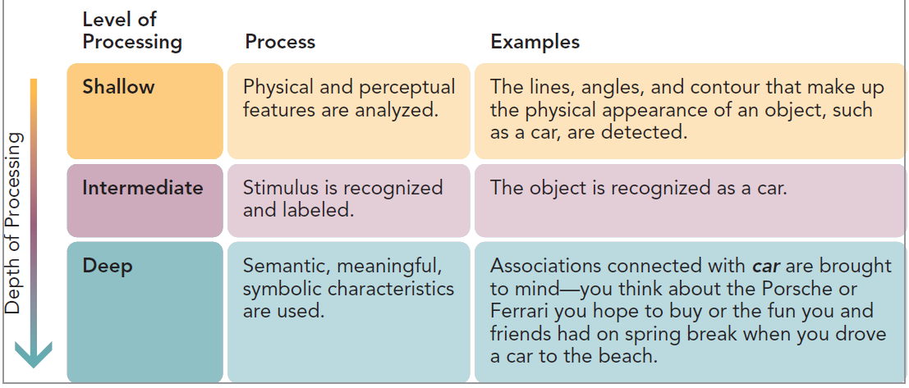
Memory Encoding Depth of Processing
Shallow – Structural, Physical and Perceptual Features
Intermediate – Phonemic and/or Recognition of Stimuli
Deep – Semantic, Connections with Past Information

Slide 8
Memory Encoding
Processing & Elaboration
Levels of processing
Continuum from shallow to deep
Deeper processing, better memory
Deep, elaborate processing is powerful
Elaboration
Number of different connections made
Evident in physical activity of brain

Slide 9
Memory Encoding
Other Strategies for Encoding
Mental Imagery
Dual-code hypothesis
Memory for pictures better than memory for words
Pictures stored as both image codes and verbal codes
Mnemonics

Slide 10
Memory Storage
How information is:
Retained over time
Represented in memory
Atkinson-Shiffrin theory
Sensory memory
Short-term memory
Long-term memory

Slide 11
Atkinson and Shiffrin’s Theory of Memory

Slide 12
Sensory Memory
Holds information in sensory form for an instant
Echoic memory
Auditory sensory memory
Retained for up to several seconds
Iconic memory
Visual sensory memory
Retained for only about ¼ second

Slide 13
Short-Term Memory
Limited-capacity (7±2 items)
Information retained for up to 30 seconds, without strategies to retain it longer
Chunking
Grouping information into higher-order units
Rehearsal
Conscious repetition of information

Slide 14
Can You Remember These?
1776200119951970179219402007
?
510152025303540
?
300305310320330340350
?
issheilagoingtobuythenewphone

Slide 15
Working Memory
Alternative approach to explaining short-term memory
Three-part system to hold information temporarily
Phonological loop
Briefly stores speech-based information

Slide 16
Long-Term Memory
Relatively permanent memory
Stores huge amounts of information for long time
Explicit memory
Implicit memory

Slide 17
Explicit (Declarative) Memory
Conscious recollection of information that can be verbally communicated
Permastore content
Episodic memory
Autobiographical information
Semantic memory
Knowledge about the world

Slide 18
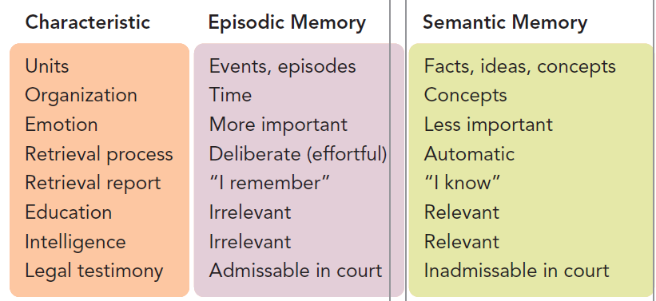
Some Differences Between Episodic and Semantic Memory

Slide 19
Implicit (Nondeclarative) Memory
Nonconscious recollection of skills and sensory perceptions
Procedural memory
Memory for skills
Classical conditioning
Memory for associations between stimuli
Priming
Activation of information already in storage

Slide 20
Memory: Location
Neurons
Memory located in specific circuits of neurons
Neurotransmitters play a role in forging connections
Long-term potentiation
Simultaneous activation of neurons strengthens memory

Slide 21
Memory: Location
Brain structures
Explicit memory
Hippocampus, temporal lobes, limbic system (amygdala)
Implicit memory
Cerebellum, temporal lobes, hippocampus

Slide 22
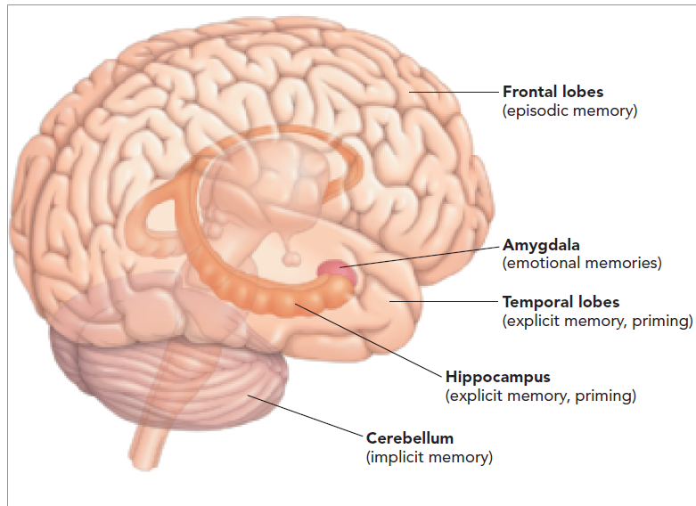
Figure 6.12 – Structures of the Brain Involved in Different Aspects of Long-Term Memory

Slide 23
Memory: Retrieval
When information retained in memory comes out of storage
Serial position effect
Tendency to recall items at beginning and end of lists
Primacy effect
Better recall for items at beginning of list
Recency effect
Better recall for items at end of list

Slide 24
Memory: Retrieval
Factors
Retrieval cues
Retrieval task
Recall
Memory task to retrieve previously learned information
Recognition
Memory task to identify, or recognize, learned items

Slide 25
Memory: Retrieval
Encoding specificity principle
Information present at time of learning tends to be effective as retrieval cue
Context-dependent memory
Remembering better when attempting to recall information in same context in which it was learned

Slide 26
Memory: Retrieval
Autobiographical memories
Special form of episodic memory containing recollections of own life experiences

Slide 27
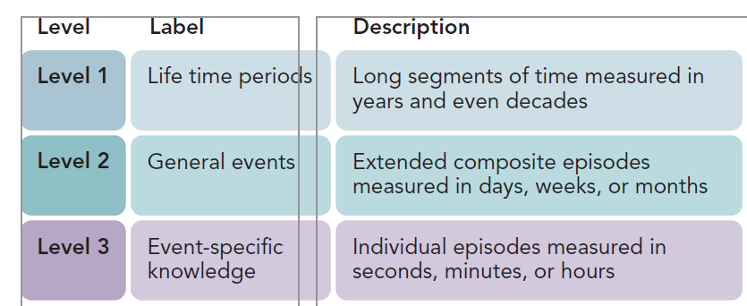
Figure 6.15 - The Three-Level Hierarchical Structure of Autobiographical Memory

Slide 28
Memory: Retrieval
Flashbulb memory
Emotionally significant events
Recalled with vivid imagery
Memory for traumatic events
May contain inaccuracies

Slide 29
Memory: Retrieval
Repressed memories
Defense mechanism by which person, traumatized by an event, forgets it – and then forgets act of forgetting
May be special case of motivated forgetting

Slide 30
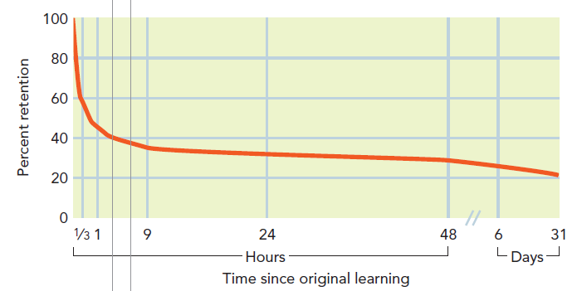
Figure 6.16 - Ebbinghaus’s Forgetting Curve

Slide 31
Forgetting
Encoding failure
Not ‘forgotten’ but, never encoded
Information never entered into long-term memory
Retrieval failure
Forgotten information

Slide 32
Forgetting: Interference
Forgetting because other information gets in way of remembering
Proactive interference
Material learned earlier disrupts retrieval of material learned later
Retroactive interference
Material learned later disrupts retrieval of material learned earlier

Slide 33
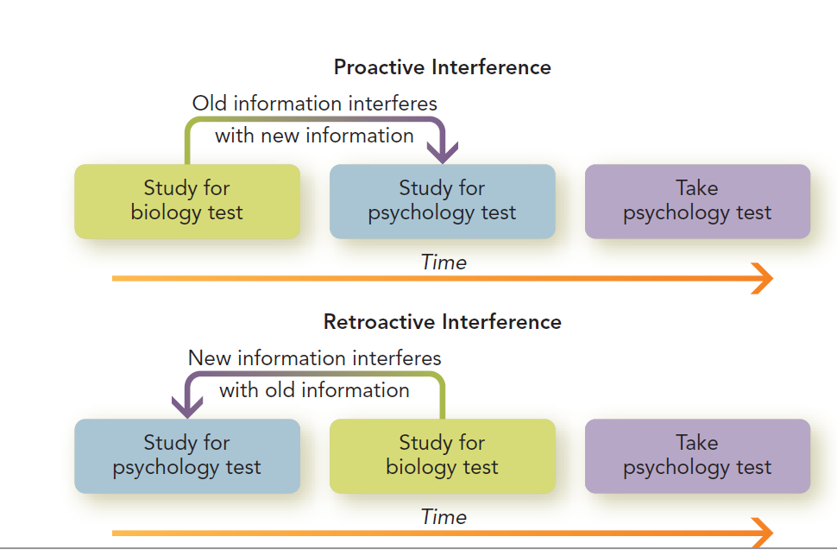
Figure 6.18 - Proactive and Retroactive Interference

Slide 34
Forgetting
Decay
Neurochemical memory ‘trace’ disintegrates over time
Cannot, alone, explain forgetting
Tip-of-the-tongue phenomenon (TOT state)
Confident of knowing something but unable to retrieve it from memory

Slide 35
Amnesia
Loss of memory
Anterograde amnesia
Disorder that affects retention of new information
Retrograde amnesia
Memory loss for a segment of past, but not for new events

Slide 36
Applying Memory Tips
To your studies:
Organize
Encode
Rehearse
Retrieve
To your life:
Autobiographical memory and the life story
Generative (vs. contamination) life stories

