Slide 1
Chapter 12
Psychological Disorders

Slide 2
Chapter Preview
Defining and Explaining Abnormal Behavior
Anxiety and Anxiety Related Disorders
Disorders Involving Emotion and Mood
Eating Disorders
Dissociative Disorders
Schizophrenia
Personality Disorders
Combatting Stigma

Slide 3
Abnormal Behavior
Mental illness that affects or is manifested in the brain and can affect thinking, behavior, and interaction with others
Deviant
Atypical and culturally unacceptable
Maladaptive
Interferes with effective functioning
Personally distressful
Over long period of time

Slide 4
Theoretical Approaches
Biological approach
Attributes psychological disorders to organic, internal causes
Medical model
Describes psychological disorders as medical diseases
Mental illnesses of patients treated by doctors
Psychological approach
Emphasizes contributions of experiences, thoughts, emotions, and personality

Slide 5
Theoretical Approaches
Sociocultural approach
Emphasizes social contexts in which person lives
Stresses cultural influences on understanding and treatment of psychological disorders
Biopsychosocial approach
Unique combinations of biological, psychological, and sociocultural factors

Slide 6
Classification Systems
Common basis for communicating
Can help make predictions
May benefit person suffering from symptoms
May also create stigma
Diagnostic & Statistical Manual of Mental Disorders - DSM
Published by American Psychiatric Association
Classification of psychological disorders in U.S.

Slide 7
DSM-V: Critiques
Treatment of psychological disorders as medical illnesses
Takes a biological view of disorders that have roots in social experiences
Does not equally emphasize strengths and weaknesses that might help to destigmatize psychological disorders

Slide 8
DSM-V: Critiques
Relies too much on social norms and subjective judgments
Many new categories of disorders added that do not have consistent research support
Standards of some existing diagnoses have been loosened

Slide 9
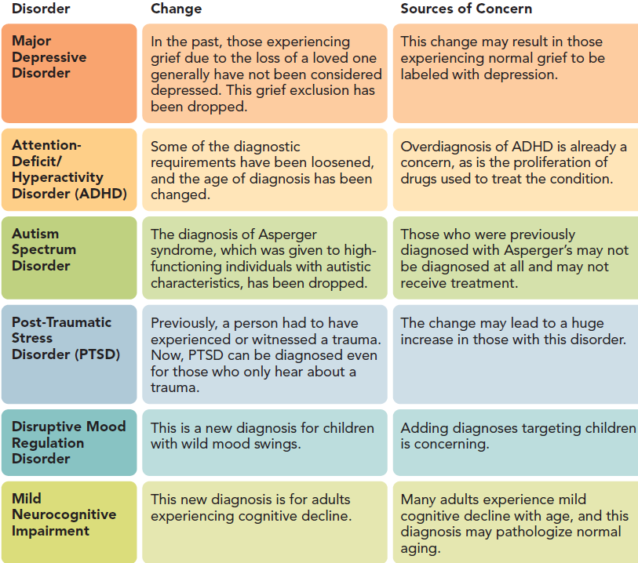
New Features of DSM-5

Slide 10
Anxiety Disorders
Involve fears that are:
Uncontrollable
Disproportionate to actual danger
Disruptive of ordinary life

Slide 11
Anxiety Disorders
Generalized anxiety disorder
Panic disorder
Specific phobia
Social anxiety disorder
Obsessive-compulsive disorder
(Obsessive-Compulsive and Related Disorders)
Post-traumatic stress disorder
(Trauma- and Stressor-Related Disorders)

Slide 12
Generalized Anxiety Disorder
Persistent anxiety for at least 6 months
Unable to specify reasons for the anxiety
Etiology (Cause)
Biological factors
Psychological and sociocultural factors

Slide 13
Panic Disorder
Recurrent, sudden onsets of intense apprehension or terror
Often occur without warning and no specific cause
Etiology
Biological factors
Psychological factors
Sociocultural factors

Slide 14
Specific Phobia Disorder & Social Anxiety Disorder
Specific disorder
Irrational, overwhelming, persistent fear of particular object or situation
Social anxiety disorder
Intense fear of being humiliated or embarrassed in social situations
Etiology
Biological factors
Psychological factors

Slide 15
Obsessive-Compulsive Disorder
Obsessions
Recurrent, anxiety-provoking thoughts
Compulsions
Repetitive, ritualistic behaviors
Checking, cleansing, counting
Etiology
Biological factors
Psychological factors

Slide 16
OCD-Related Disorders
Hoarding disorder
Excoriation
Trichotillomania
Body dysmorphic disorder

Slide 17
Post-Traumatic Stress Disorder
Develops through exposure to traumatic event that overwhelms abilities to cope
Flashbacks
Avoiding emotional experiences
Reduced ability to feel emotions
Excessive arousal
Difficulties with memory and concentration
Impulsive behavior

Slide 18
Post-Traumatic Stress Disorder
Can follow trauma immediately or be delayed
Combat and war-related traumas
Sexual abuse and assault
Natural disasters
Unnatural disasters
Etiology
Trauma
Other factors

Slide 19
Depressive Disorders
Depression
Unrelenting lack of pleasure in life
Major depressive disorder
Significant depressive episode and depressed characteristics for at least two weeks
Impaired daily functioning
Persistent depressive disorder (Dysthmia)
Chronic depression, less acute symtoms

Slide 20
Depressive Disorders: Etiology
Biological factors
Genetic influences
Brain structures
Neurotransmitter regulation
Psychological factors
Learned helplessness
Cognitive explanations
Sociocultural factors
Socioeconomic status (SES)
Gender differences

Slide 21
Bipolar Disorder
Extreme mood swings, including one or more episodes of mania
Overexcited, unrealistically optimistic state
Multiple cycles of depression interspersed with mania
Cyclothymia – chronic, but less acute depression
Etiology
Genetic influences
Biological processes

Slide 22
Suicide
Biological factors
Genetic factors
Neurotransmitter levels
Psychological factors
Mental disorders and traumas
Substance abuse
Sociocultural factors
Economic hardship
Cultural and ethnic contexts
Gender differences

Slide 23
Eating Disorders
Characterized by extreme disturbances in eating behavior
Anorexia nervosa
Bulimia nervosa
Binge eating disorder

Slide 24
Anorexia Nervosa
Relentless pursuit of thinness through starvation
Weighing less than 85% of normal weight
Intense fear of gaining weight
Distorted body image
Physical changes, serious complications, and high mortality rate
High-achieving perfectionism

Slide 25
Bulimia Nervosa
Binge-and-purge eating pattern
Preoccupation with food
Strong fear of becoming overweight
Depression or anxiety
Difficult to detect
Complications and dental problems
High perfectionism, low self-efficacy

Slide 26
Anorexia & Bulimia: Etiology
Sociocultural factors
Previously believed to be central determinants
No longer sole focus
Biological factors
Of increasing focus in research
Genes
Regulation of serotonin

Slide 27
Binge-Eating Disorder
Recurrent episodes of eating large amounts of food
Lack of control over eating
Overweight or obese
Experience of guilt and shame
Biological factors
Genes
Dopamine
Psychological factor
Stress

Slide 28
Dissociative Disorders
Dissociation
Psychological states of disconnection from immediate experience
Dissociative disorders
Involve sudden loss of memory or change of identity, under extreme stress or shock
Dissociative amnesia
Dissociative fugue
Dissociative identity disorder

Slide 29
Dissociative Amnesia & Fugue
Amnesia
Inability to recall important events
Dissociative amnesia
Extreme memory loss caused by extensive psychological stress
Dissociative fugue
Amnesia, plus traveling away from home and assuming new identity

Slide 30
Dissociative Identity Disorder
Formerly called multiple personality disorder
Two or more distinct personalities or selves
Each has its own memories, behaviors, relationships
One personality dominates at one time
Wall of amnesia separates personalities
Shift between personalities occurs under distress

Slide 31
Dissociative Identity Disorder
Exceptionally high rate of sexual or physical abuse during early childhood
Majority are women
Genetic predisposition may exist

Slide 32
Schizophrenia
Characterized by highly disordered thought processes
Psychotic or far removed from reality
Positive symptoms
Marked by distortion or excess of normal function
Negative symptoms
Reflect social withdrawal, behavioral deficits, and loss or decrease of normal functions

Slide 33
Schizophrenia: Positive Symptoms
Hallucinations
Sensory experiences in absence of real stimuli
Often auditory
Delusions
False, unusual, or magical beliefs
Not part of individual’s culture

Slide 34
Schizophrenia: Positive Symptoms
Thought disorder
Unusual, sometimes bizarre thought processes
Word salad
Incoherent, loose word associations
New words
Referential thinking
Ascribing personal meaning to random events
Disorders of movement
Catatonia
State of immobility and unresponsiveness over time

Slide 35
Schizophrenia: Symptoms
Negative symptoms
Flat affect
Display of little or no emotion
Lacking ability to read emotions of others
Cognitive symptoms
Difficulty sustaining attention
Problems holding information in memory
Inability to interpret information and make decisions

Slide 36
Schizophrenia: Causes
Biological factors
Heredity
Structural brain abnormalities
Problems in neurotransmitter regulation
Psychological factors
Diathesis-stress model
Combination of biogenetic predisposition and stress
Sociocultural factors
Socioeconomic level and other sociocultural factors

Slide 37
Personality Disorders
Chronic, maladaptive cognitive-behavioral patterns integrate into personality
Antisocial personality disorder
Borderline personality disorder

Slide 38
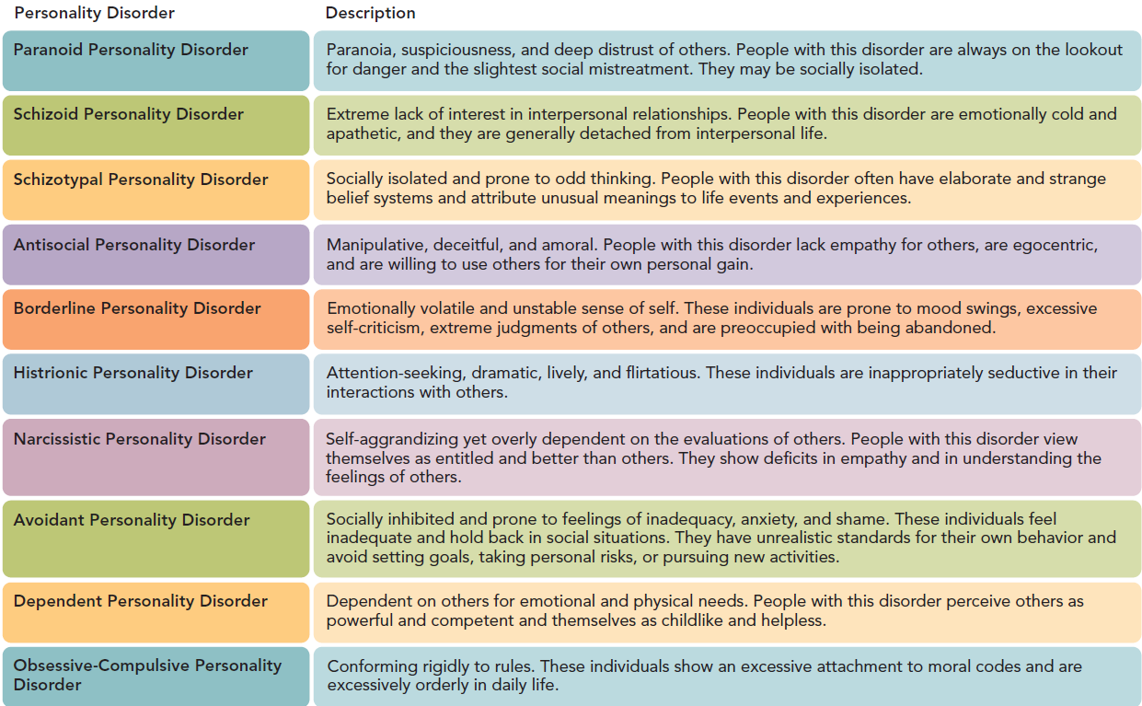
Personality Disorders

Slide 39
Antisocial Personality Disorder
Characterized by guiltlessness, law breaking, exploitation of others, irresponsibility, and deceit
Biological factors
Genetically heritable
Brain differences
Autonomic nervous system differences

Slide 40
Antisocial Personality Disorder
Psychopaths
Subgroup of individuals with ASPD
Remorseless predators who engage in violence

Slide 41
Borderline Personality Disorder
Pervasive pattern of instability in:
Interpersonal relationships
Self-image
Emotions
Marked impulsivity beginning by early adulthood and present in various contexts
Splitting
Thinking style characterized by seeing the world in black and white terms

Slide 42
Borderline Personality Disorder
Potential causes are complex
Biological factors
Genetic heritability
Childhood experiences
Childhood sexual abuse
Cognitive factors
Irrational beliefs
Hypervigilance

Slide 43
Combating Stigma
Rosenhan study (1973)
Labels of psychological disorders can be very ‘sticky’
Labels color perception of everything else person does
Consequences of stigma
Prejudice and discrimination
Physical health
Overcoming stigma
Recognize strengths and achievements

