Slide 1
Chapter 11
Social Psychology

Slide 2
Chapter Preview
Social Cognition
Social Behavior
Social Influence
Intergroup Relations
Close Relationships

Slide 3
Social Psychology
Study of how people think about, influence, and relate to others
Examines many topics in psychology in a social context

Slide 4
Social Cognition
Explores how people select, interpret, remember, and use social information
Person perception
Attribution
The self as a social object
Attitudes

Slide 5
Person Perception
Processes by which social stimuli, such as faces, are used to form impressions of others
Physical attractiveness
“Beautiful is good” stereotype
Power of expectations
Average vs. Symmetrical (http://faceresearch.org/)
First Impressions
Primacy effect

Slide 6
Attribution
Attribution theory
People as motivated to discover underlying causes of behavior to make sense of behavior
Internal/external causes
Stable/unstable causes
Controllable/uncontrollable causes

Slide 7
Attributional Errors and Biases
Actor
Produces behavior
Explanations for behavior in terms of external causes
Observer
Offers causal explanation of the actor’s behavior
Explanations in terms of internal causes

Slide 8
Attributional Errors and Biases
Fundamental attribution error
Committed by observers explaining actor’s behavior
Overestimation of internal traits
Underestimation of external situations

Slide 9
Attributional Errors and Biases
False consensus effect
Overestimation of degree to which everybody else thinks or acts as we do
Self-serving bias
Tendency to take credit for successes and deny responsibility for failures

Slide 10
The Self as a Social Object
Self-esteem
Positive or negative evaluation of self
Positive illusions
Positive views of self not necessarily rooted in reality

Slide 11
The Self as a Social Object
Stereotype threat
Fast-acting, self-fulfilling fear of being judged based on a negative stereotype
Social comparison
Process of evaluating thoughts, feelings, behaviors, and abilities in relation to similar others

Slide 12
Attitudes → Behavior
Attitudes
Opinions and beliefs about people, objects, ideas
Attitudes predict behavior when:
Attitudes are strong
We show awareness of attitudes and practice them
We have a vested interest

Slide 13
Behavior → Attitudes
Cognitive dissonance theory
Discomfort caused by inconsistent thoughts can be reduced by:
Behavior to fit attitude
Attitude to fit behavior
Effort justification
Rationalizing the amount of effort put into something
Self-perception theory
Inferences about attitudes by perceiving behavior

Slide 14
Persuasion
Trying to change someone’s attitude
Elements include:
Communicator (Source)
Medium
Target
Message

Slide 15
Persuasion
Elaboration Likelihood Model
Central route
Engaging someone with sound, logical argument
Peripheral route
Involves non-message factors
Effective when people not paying attention to communicator

Slide 16
Persuasion
Inoculation
Resistance to persuasion accomplished by giving a weak version on persuasive message and allowing time to argue against it

Slide 17
Altruism: Social Behavior
Unselfish interest in helping another person
Also referred to as prosocial behavior
Egoism
Giving to another to ensure reciprocity, to gain self-esteem, to present oneself in a particular way, or to avoid social censure
Reciprocity
Acting kindly toward others because they might do the same for us someday

Slide 18
Altruism: Social Behavior
Emotions
Empathy
Gender

Slide 19
Altruism: Bystander Effect
Kitty Genovese case
Tendency for observer of emergency to help less when others present
Due to:
Diffusion of responsibility
Tendency to look to behavior of others for cues

Slide 20
Aggression: Biological Influences
Evolutionary views
Innate aggressive responses
Genetic basis
Proactive physical aggression in humans

Slide 21
Aggression: Biological Influences
Neurobiological factors
Brain areas → Limbic system
Frontal lobes
Neurotransmitters → Serotonin
Hormones → Testosterone

Slide 22
Aggression: Psychological Factors
Frustration-aggression hypothesis
Frustration, blocking attempts to reach goal, always leads to aggression
Other aversive experiences can cause aggression

Slide 23
Aggression: Psychological Factors
Cognitive determinants
Aspects of environment, such as presence of weapons
Perceptions of unfairness
Observational learning

Slide 24
Aggression: Sociocultural Factors
Cultural variations
Gap between rich and poor
Cultural norms about masculine pride and family honor
Culture of honor
Man’s reputation as an essential aspect of economic survival

Slide 25
Aggression: Sociocultural Factors
Media violence
Can prompt aggressive/antisocial behavior in children
Violent pornography may have some effect on male sexual aggression

Slide 26
Social Behavior: Aggression
Aggression and gender
Generally, males are more aggressive than females
Reducing aggression
Decrease rewards for and exposure to aggression
Parenting strategies
Encourage children to develop empathy toward others
Monitor adolescents’ activities

Slide 27
Social Influence
How behavior is influenced by other individuals and groups
Conformity
Obedience
Group influence

Slide 28
Conformity
Change in behavior to coincide with group standard
Asch (1951)
Line experiment, using confederates
Participants conformed to incorrect answers 35% of time

Slide 29
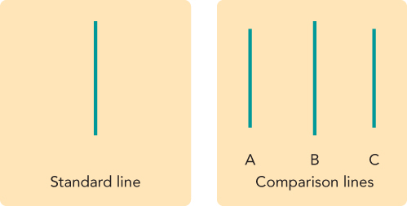
Asch’s Conformity Experiment

Slide 30
Conformity
Informational social influence
When we want to be right
Depends on how:
Confident we are in our independent judgment
Well-informed we perceive the group to be
Normative social influence
When we want to be liked

Slide 31
Conformity
Conformity and the brain
Brain may actually “feel better” when we fit in
Conformity and culture
Collectivist cultures has been associated with greater levels of conformity
Cultural norms provide clues about how groups of human beings have managed to adapt to life

Slide 32
Obedience
Behavior that complies with explicit demands of authority
Milgram (1965, 1974)
Electric shock experiment with a confederate
Majority of participants obeyed the experimenter
Disobedience more common when:
Others disobeyed
Authority figure not legitimate, or not close by
Victim made to seem more human

Slide 33
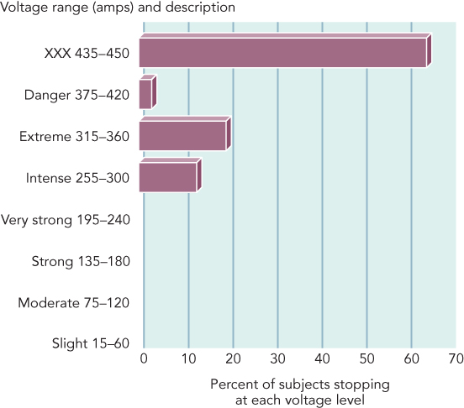
Milgram Obedience Study

Slide 34
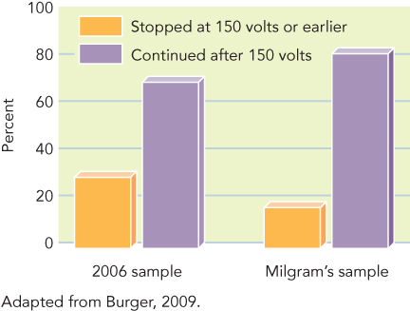
Milgram Obedience Study

Slide 35
Group Influence
Stanford Prison Experiment
Deindividuation
Reduction of personal identity and erosion of personal responsibility, when part of a group
May be due to anonymity
Social contagion
Imitative behavior involving spread of behavior, emotions, and ideas

Slide 36
Group Decision Making
Risky shift
Tendency for group decision to be riskier than the average decision made by the individual group members
Group polarization
Solidification and strengthening of individual position as a result of group discussion
May result from persuasion or social comparison

Slide 37
Group Decision Making
Groupthink
Conformity over accuracy
Prevented if groups:
Avoid isolation
Allow all sides of an argument to be aired
Have an impartial leader
Include outside experts

Slide 38
Group Performance
Social facilitation
Improvement in individual performance due to the presence of others
Due to effects of arousal, only on well-learned tasks

Slide 39
Group Performance
Social loafing
Tendency to exert less effort in group due to less accountability for individual effort
Decreased by increasing identifiability, simplifying evaluation, and making group task more attractive

Slide 40
Intergroup Relations
Group identity: Us vs. Them
Social identity
Defining self in terms of group membership
Crucial part of self-image and source of good feelings
In-group vs. out-group
Minimal groups
Ethnocentrism
Tendency to favor one’s own ethnic group

Slide 41
Intergroup Relations: Prejudice
Unjustified negative attitude based on group membership
Explicit racism
Conscious and openly shared attitude
Implicit racism
Attitude on deeper, hidden level

Slide 42
Intergroup Relations: Prejudice
Factors
Competition between groups, scarcity of resources
Cultural learning
Low self-esteem
Limits information-processing abilities

Slide 43
Intergroup Relations: Prejudice
Stereotypes
Generalizations about group
More likely to stereotype out-group members

Slide 44
Intergroup Relations
Discrimination
Unjustified negative or harmful action based on group membership
Improving intergroup relations
Certain types of contact
Task-oriented cooperation
Sherif’s (1961) Robbers Cave study
Aronson’s (1986) Jigsaw Classroom

Slide 45
Types of Social Identity

Slide 46
Close Relationships: Attraction
Proximity
Physical closeness as strong predictor of attraction
Mere exposure effect
Encounters increase liking, even without realizing it
Consensual validation
Explains why people are attracted to others who are similar to them

Slide 47
Close Relationships: Attraction
Evolutionary approaches
Gender differences in attraction variables based on different roles in procreation
Males focus on quantity of sexual partners
Females focus on quality and resources
Criticism
Humans have the decision-making ability to change their gender behavior

Slide 48
Close Relationships: Attachment
Secure style
Positive views of relationships, easy to get close to others and not concerned about romance
Avoidant style
Hesitant about getting involved in romance
Once in a relationship tend to distance themselves from their partner
Anxious style
Demand closeness, less trusting, more emotional, jealous, and possessive

Slide 49
Close Relationships: Love
Romantic (passionate) love
Strong components of sexuality and infatuation
Predominates in early part of love relationship
Affectionate (companionate) love
Deep, caring affection for another person

Slide 50
Close Relationships: Love
Gender
Men conceptualize love in terms of passion
Women in terms of friendship

Slide 51
Models of Close Relationships
Social exchange theory
Focus on minimizing costs and maximizing benefits
Equity as most important predictor of success, especially early in relationships
Investment model
Focus on underlying factors of relationships
Examines commitment, investment, and availability of attractive alternative partners

