Slide 1
Chapter 10
Personality

Slide 2
Chapter Preview
Psychodynamic Perspectives
Humanistic Perspectives
Trait Perspectives
Personological and Life Story Perspectives
Social Cognitive Perspectives
Biological Perspectives
Personality Assessment

Slide 3
Personality
Pattern of enduring, distinctive:
Thoughts
Emotions
Behaviors
Characterize how an individual adapts to the world

Slide 4
Psychodynamic Perspectives
Emphasize that personality is primarily unconscious, or beyond awareness
Freud’s psychoanalytic theory
Sexual drive
Most important human motivator
Main determinant of personality
Hysteria
Physical symptoms that have no physical cause
Symptoms stemmed from unconscious psychological conflicts

Slide 5
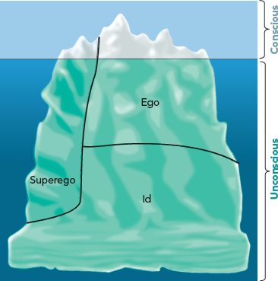
Structures of Personality
Id
Consists of unconscious drives
Reservoir of sexual energy
Works according to pleasure principle
Ego
Deals with demands of reality
Abides by the reality principle
Superego
Evaluates morality of behavior
Reflected in “conscience”

Slide 6
Defense Mechanisms
Tactics the ego uses to reduce anxiety by unconsciously distorting reality
Repression
Displacement
Reaction Formation
Sublimation

Slide 7
Psychosexual Stages of Personality Development
Erogenous zones
Parts of body that have strong pleasure-giving qualities at particular stages of development
Adult personality is determined by the way conflicts are resolved between early sources of pleasure and demands of reality
Fixation in the stage

Slide 8
Psychosexual Stages of Personality Development
Oral stage (first 18 months)
Pleasure centers around mouth
Chewing, sucking, biting reduce tension
Anal stage (18 to 36 months)
Pleasure centers around anus and urethra and their functions
Toilet training
Phallic stage (3 to 6 years)
Pleasure focuses on genitals
Discovery that self-stimulation is enjoyable

Slide 9
Phallic Stage
Oedipus complex
Castration anxiety
Development of superego
Electra complex
Penis envy

Slide 10
Psychosexual Stages of Personality Development
Latency period (6 years to puberty)
Setting aside all interest in sexuality
No real development
Genital stage (adolescence to adulthood)
Sexual reawakening
Source of sexual pleasure shifts to someone outside the family

Slide 11
Defense Mechanisms & Freudian Stages

Slide 12
Jung’s Analytical Theory
Three levels of conscious
Conscious, Personal unconscious, Collective unconscious
Collective unconscious
Impersonal, deepest layer of the unconscious mind
Archetypes
Emotionally laden ideas having symbolic meaning
Anima & animus
Persona

Slide 13
Adler’s Individual Psychology
People motivated by purposes, goals
Perfection, not pleasure, as key motivator
Compensation and Overcompensation
Birth order

Slide 14
Humanistic Perspectives
Person’s capacity for personal growth
Positive human qualities
Ability to:
control our lives
achieve what we desire
Abraham Maslow (1908-1870)
Carl Rogers (1902-1987)

Slide 15
Maslow’s Hierarchy of Needs
Sequence of needs to satisfy
Strongest needs at base, weakest at top
Lower needs reflect deficiencies
Needs are motivating

Slide 16
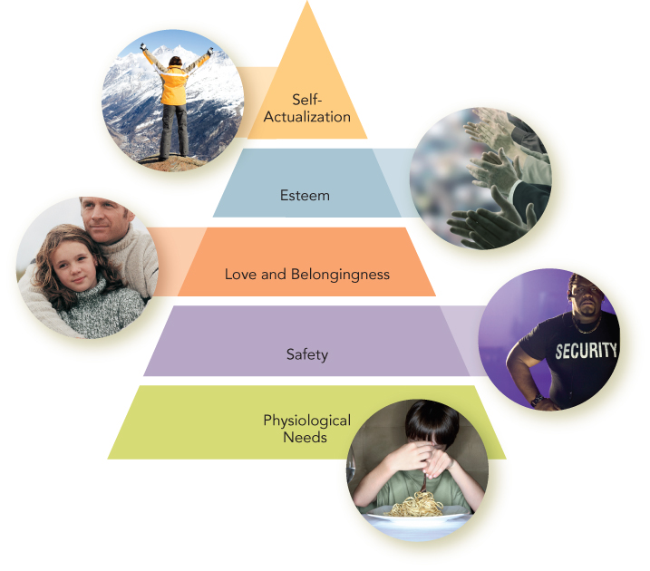
Maslow’s Hierarchy of Needs

Slide 17
Rogers’ Approach
Unconditional positive regard
Being accepted, valued, and treated positively
Conditional positive regard
Conditions of worth
Self-concept
Representation of who we are and who we wish to be. Real vs. Ideal Self

Slide 18
Self-Concept
Incongruence
Congruence
Real
Self
Ideal
Self
Real
Self
Ideal
Self

Slide 19
Rogers’ Approach
Optimal functioning
Unconditional positive regard
Empathy
Genuineness

Slide 20
Trait Perspectives
Gordon Allport (1897-1967)
Focus on healthy, well-adjusted individuals
Uniqueness of each person and capacity to adapt
Traits
Mental structures that make different situations the same for the person
Lexical approach & factor analysis
If a trait is important to people in real life, it ought to be represented in the natural language people use to talk about one another

Slide 21
Five-Factor Model
Neuroticism (emotional instability)
Extraversion
Openness to experience
Agreeableness
Conscientiousness

Slide 22
outgoing
assertive
Agreeableness
Neuroticism (Negative Emotionality)
Conscientiousness
(Constraint)
Extraversion (Positive Emotionality)
upbeat
friendly
Extraversion (Positive Emotionality)
Openness to Experience
gregarious
sociable
Notes:
More recently, McCrae and Costa have used factor analysis to arrive at an even simpler, five-factor model of personality: the big five. High Extraversion scores signify that a person is outgoing, sociable, upbeat, friendly, assertive, and gregarious. Some trait models refer to this as positive emotionality.

Slide 23
anxious
vulnerable
Agreeableness
Neuroticism (Negative Emotionality)
Conscientiousness
(Constraint)
Neuroticism (Negative Emotionality)
insecure
Extraversion (Positive Emotionality)
self-conscious
Openness to Experience
hostile
Notes:
High Neuroticism scores signify that a person is anxious, hostile, self-conscious, insecure, and vulnerable - some models call this negative emotionality.

Slide 24
curiosity
Agreeableness
flexibility
artistic sensitivity
Neuroticism (Negative Emotionality)
Conscientiousness
(Constraint)
Openness to Experience
imaginativeness
Extraversion (Positive Emotionality)
Openness to Experience
vivid fantasy
unconventional attitudes
Notes:
Openness to experience is associated with curiosity, flexibility, vivid fantasy, imaginativeness, artistic sensitivity, and unconventional attitudes.

Slide 25
sympathetic
Agreeableness
trusting
Neuroticism (Negative Emotionality)
Conscientiousness
(Constraint)
Agreeableness
modest
cooperative
Extraversion (Positive Emotionality)
Openness to Experience
straight forward
Notes:
Agreeableness is associated with people who are sympathetic, trusting, cooperative, modest, and straightforward. It may have its roots in temperament.

Slide 26
diligent
Agreeableness
punctual
Neuroticism (Negative Emotionality)
Conscientiousness
(Constraint)
Conscientiousness
(Constraint)
disciplined
dependable
Extraversion (Positive Emotionality)
Openness to Experience
well-organized
Notes:
Conscientious people are diligent, disciplined, well organized, punctual, and dependable. Some models refer to this trait as constraint, related to high productivity in a variety of occupational areas.

Slide 27
Five-Factor Model
Evidence of five factors of personality in:
Different cultures
Animals
Strong relationship between personality traits and well-being
Extraversion → Higher levels of well-being
Neuroticism → Lower levels of well-being

Slide 28
Five-Factor Model
Subjective well-being
Person’s assessment of his/her own level of positive affect
Traits as enduring characteristics
States are briefer experiences, such as mood

Slide 29
Social Cognitive Perspectives
Incorporate principles from behaviorism
Emphasize:
conscious awareness
beliefs
expectations
goals
reasoning
thinking about past, present, and future
reflecting on the self

Slide 30
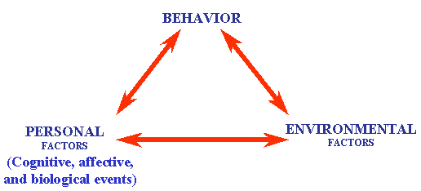
Bandura’s Social Cognitive Theory
Observational learning
Reciprocal determinism
Interaction of behavior, environment, and person/cognitive factors to create personality
Personal control
Internal locus of control
External locus of control
Self-efficacy
Belief that one can master situation and produce positive change

Slide 31
Mischel’s Contributions
Critique of consistency in behavior
No evidence of cross-situational consistency
Situationism
Personality and behavior vary from one context to another

Slide 32
Mischel’s Contributions
CAPS theory
Cognitive affective processing systems
Thoughts and emotions about self/world affect behavior
Concerned with how personality works

Slide 33
Evaluation of Social Cognitive Perspectives
Focuses on interactions of person with environment
Highlights observation of behavior
Emphasizes influence of cognitive processes

Slide 34
Social Cognitive Perspective
Criticisms
Concerned with change and situational influences
Ignores role of biology in personality
Makes generalizations impossible

Slide 35
Biological Perspectives
Hippocrates
Personality based on bodily fluids, or humours
Freud
Connection between the mind and body
Allport
Traits as neuropsychic, personality as psychophysical
Murray
No brain, no personality

Slide 36
Eysenck’s RAS Theory
Reticular activating system (RAS)
Located in the brain stem
Plays role in wakefulness or arousal
Eysenck’s theory
All share optimal arousal level
RAS of extraverts and introverts may differ in baseline levels of arousal

Slide 37
Gray’s Reinforcement Sensitivity
Behavior approach system (BAS)
Sensitive to rewards
Predisposition to positive emotion
Underlies extraversion
Behavioral inhibition system (BIS)
Sensitive to punishers
Predisposition to fear
Underlies neuroticism

Slide 38
Role of Neurotransmitters
Dopamine
Function in experience of reward
Factor in BAS or extraversion
Serotonin
Related to neuroticism
Less serotonin → More negative mood
Inhibition of serotonin reuptake
Decreases negative mood
Enhances feelings of sociability
Does not tell us about potential causal pathways

Slide 39
Behavior Genetics
Study of inherited underpinnings of behavioral characteristics
Twin studies
Genetic factors explain differences in big five traits
Autobiographical memories influenced by genetics
Role of genetic factors enormously complex
Genes and environments intertwined
Traits influenced by multiple genes

Slide 40
Biological Perspectives
Tie personality to :
Animal learning models
Advances in brain imaging
Evolutionary theory
Cautions
Biology can be effect, not cause, of personality
Issue of whether personality can change throughout life

Slide 41
Personality Assessment
Rigorous methods for measuring mental processes
Assess personality for different reasons
Self-report tests
Projective tests
Other assessment methods

Slide 42
Self-Report Tests
Directly ask people whether different items describe their personality traits
Social desirability
Motivates individuals to respond in ways that make them look better

Slide 43
Self-Report Tests
To address social desirability
Give questionnaire designed to tap into tendency
Design scales so it is impossible to tell what is being measured
Use empirically-keyed test to distinguish known groups

Slide 44
Self-Report Tests
MMPI
Most widely used and researched empirically-keyed self-report personality test
Used to assess personality and predict outcomes
NEO-PI-R
Geared toward assessing the five-factor model
Includes items with face validity

Slide 45
Projective Tests
Present individuals with ambiguous stimulus
Ask them to describe it, or tell a story about it
Especially designed to elicit unconscious feelings and conflicts
Theoretically aligned with psychodynamic perspectives on personality

Slide 46
Projective Tests
Rorschach inkblot test
Responses are scored based on indications of various underlying psychological characteristics
Reliability and validity criticized
Thematic Apperception Test (TAT)
Designed to elicit stories that reveal personality
Greater reliability and validity

Slide 47
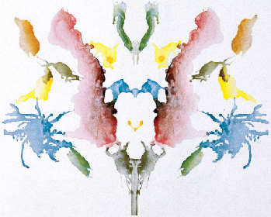
Type of Stimulus Used in the Rorschach Inkblot Test

Slide 48
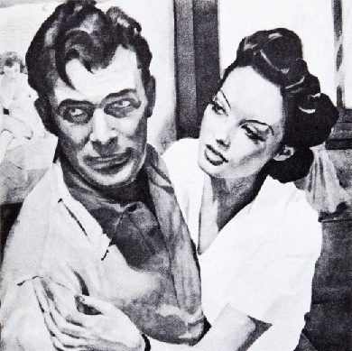
Picture from the Thematic Apperception Test (TAT)

