Slide 1
Mindset and Motivation
Donna Vandergrift
Welcome Back to RCBC Day
8/31/15

Slide 2
Community College Students
Motivation and our students
Mindset
Neuroplasticity
What can we do?

Slide 3

Motivation
We don’t see unmotivated children.

Slide 4

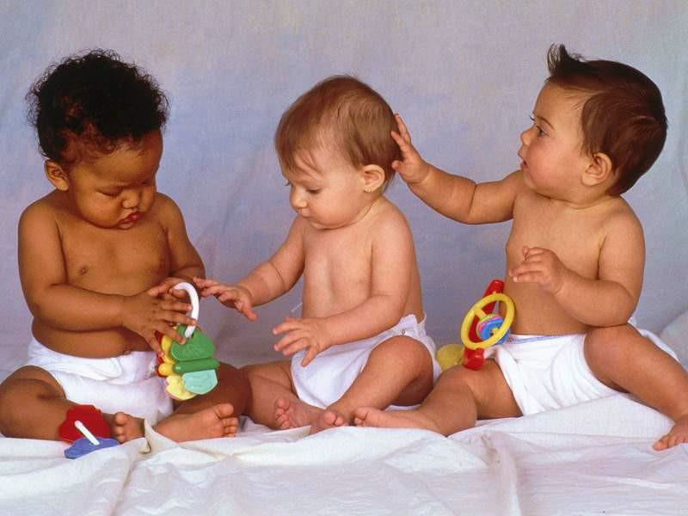
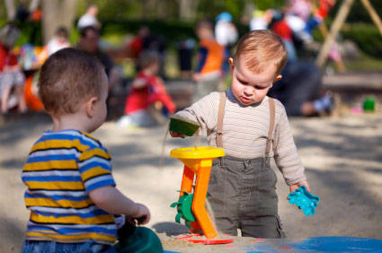
Motivation
Children are self- motivated. Failure does affect their motivation.

Slide 5

What Happened?

Slide 6
Community College Students
SENSE: Survey of Entering Student Engagement
CCSSE: Community College Survey of Student Engagement
More than one-quarter (28%) of SENSE respondents and 19% of CCSSE respondents report that they never prepared two or more drafts of a paper or assignment before turning it in.
Approximately one third (37%) of full-time CCSSE respondents report spending five or fewer hours per week preparing for class.

Slide 7
Community College Students
More than four in 10 (44%) of SENSE respondents and 69% of CCSSE respondents report that they came to class unprepared one or more times.
Approximately one-quarter (26%) of SENSE respondents report skipping class one or more times in the first three weeks of class.
One in 10 CCSSE respondents (10%) report that they never worked on a paper or project that required integrating ideas or information from various sources; about one-quarter (24%) of students report doing so very often.

Slide 8
CCSSE – Aspects of Lowest Student Engagement: Spring 2013 at BCC
Frequency of skills lab use (writing, math, etc.)
Frequency of skills lab use (computer labs)
Provided the support you need to help you succeed at this college
Prepared two or more drafts of a paper or assignment before turning it in
Helping you cope with non-academic responsibilities (work, family, etc.)

Slide 9
SENSE – Aspects of Lowest Student Engagement: Fall 2011 at BCC
Used face-to-face tutoring
Used writing, math, or other skills labs
Used computer lab
Participated in supplemental instruction during the first three weeks of the semester
At least one college staff member other than an instructor learned my name

Slide 10
Underprepared students are often not ready for college-level work because of gaps in one or more of the following areas:
General knowledge (e.g., history, lit, civics)
Skills areas (e.g., reading, writing, math)
Study skills and self management
Critical thinking and analysis
Technological competencies
Knowledge of behaviors leading to success
A vision supporting motivation & persistence
Willingness to take instructors’ advice

Slide 11
What do you Think the Problem is?
What are your core beliefs about our students?
What are your beliefs about intelligence and ability?
Take the Mindset Quiz.

Slide 12
Mindset
Developed by Carol Dweck, Professor, Stanford University.
Mindset a mental attitude that determines how you will interpret and respond to situations.
In a fixed mindset students believe their basic abilities, their intelligence, their talents, are just fixed traits. They have a certain amount and that’s that, and then their goal becomes to look smart all the time and never look dumb. In a growth mindset students understand that their talents and abilities can be developed through effort, good teaching and persistence. They don’t necessarily think everyone’s the same or anyone can be Einstein, but they believe everyone can get smarter if they work at it.
—Carol Dweck, Stanford University

Slide 13
MINDSET Quiz
 | Strongly Agree | Agree | Disagree | Strongly Disagree
Intelligence is something people are born with that can’t be changed.
You can always substantially change how intelligent you are.
You are a certain kind of person, and there is not much that can be done to really change that.
You can always change basic things about the kind of person you are.
The harder you work at something, the better you will be at it.
No matter what kind of person you are, you can always change substantially.
Trying new things is stressful for me and I avoid it.
I appreciate when people, parents, coaches, teachers give me feedback about my performance.
I often get angry when I get negative feedback about my performance.
All human beings are capable of learning.
You can learn new things, but you can’t really change how intelligent you are.
Truly smart people do not need to try hard.

Slide 14
Fixed Mindset
Fixed mindset thinking:
I have a set amount of intelligence and a certain character.
I feel the need to validate myself. Success is about proving I’m smart or talented…smarter or better than others. Superior.
I avoid challenges and risk taking.
I am reluctant to put effort into something that doesn’t come easily to me. You either have ability or you don’t. I feel smart when I don’t make mistakes or when I finish something fast and it’s perfect.
I thrive when things are safely within my grasp. If it’s too challenging, I lose interest.
Effort is for those who don’t have ability. If you have to work at something, you must not be good at it.

Slide 15
Growth Mindset
Growth Mindset thinking:
I believe that my talent and aptitude can change and grow through effort and experience.
I believe I can develop my ability through learning. Success is about developing myself by learning something new.
Failure is painful, but it doesn’t define me. I have to face it, learn from it and work harder.
I feel smart when I work on something hard for a long time hard and accomplish something I couldn’t do before.
I thrive when I’m stretching myself. The more challenging something is, the more interested I am.
I admire effort more than natural talent. No matter what your ability is, effort is what ignites the ability and turns it into accomplishment.

Slide 16
Responses are Based on Mindset
 | Fixed Intelligence Mindset Response | Growth Intelligence Mindset Response
Challenges | Avoid | Embrace
Obstacles | Give up easily | Persist
Tasks requiring effort | Fruitless to try | Path to mastery
Criticism | Ignore it | Learn from it
Success of others | Threatening | Inspirational

Slide 17
Mindset Research
In one study, Blackwell and her colleagues followed hundreds of students making the transition to 7th grade. They found that students with a growth mindset were more motivated to learn and exert effort, and outperformed those with a fixed mindset in math—a gap that continued to increase over the two-year period. Those with the two mindsets had entered 7th grade with similar past achievement, but because of their mindsets their math grades pulled apart during this challenging time.
Blackwell, L.S., Trzesniewski, K.H., & Dweck, C.S. (2007). Implicit theories of intelligence predict achievement across an adolescent transition: A longitudinal study and an intervention. Child Development, 78. 246-263, Study 1.

Slide 18
Mindset Research
In another study, students who received growth mindset training (compared to matched controls who received other instruction) showed significantly increases in both their math and verbal achievement test scores. It was interesting to note that girls who received the growth mindset training narrowed the gender gap in math.
Good, C., Aronson, J., & Inzlicht, M. (2003). Improving adolescents' standardized test performance: An intervention to reduce the effects of stereotype threat. Applied Developmental Psychology, 24, 645-662.

Slide 19
Mindset Research
Aronson and colleagues taught college students a growth mindset and taught the control group about multiple intelligence (don't feel bad if you don't do well in one area, you may still be smart in other areas). There was also a no-training control group. The growth mindset group showed significantly higher grades than the control groups. This was particularly true for African American students, who also showed a sharp increase in their valuing of school and their enjoyment of their academic work.
Aronson, J., Fried, C. B., & Good, C. (2002). Reducing the effects of stereotype threat on African American college students by shaping theories of intelligence. Journal of Experimental Social Psychology, 38, 113-125.

Slide 20
Mindset Research
In one study, Blackwell and her colleagues divided students into two groups for a workshop on the brain and study skills. Half of them, the control group, were taught about the stages of memory; the other half received training in the growth mindset (how the brain grows with learning to make you smarter) and how to apply this idea to their schoolwork. Three times as many students in the growth mindset group showed an increase in effort and engagement compared with the control group. After the training, the control group continued to show declining grades, but the growth-mindset group showed a clear rebound in their grades.
Blackwell, L., Trzesniewski, K., & Dweck, C.S. (2007). Implicit theories of intelligence predict achievement across an adolescent transition: A longitudinal study and an intervention. Child Development, 78. 246-263, Study 2.

Slide 21
Neuroplasticity
When people repeatedly practice an activity or access a memory, their neural networks -- groups of neurons that fire together, creating electrochemical pathways -- shape themselves according to that activity or memory.
When people stop practicing new things, the brain will eventually eliminate, or "prune," the connecting cells that formed the pathways.
Like in a system of freeways connecting various cities, the more cars going to certain destination, the wider the road that carries them needs to be. The fewer cars traveling that way, however, the fewer lanes are needed.

Slide 22
Neuroscience Research
Neuroscientists tracked students during their teenage years. For many students, they found substantial changes in performance on verbal and non-verbal IQ tests. Using neuroimaging, they found corresponding changes in the density of neurons in the relevant brain areas for these students. In other words, an increase in neuronal connections in the brain accompanied an increase in IQ-test performance, while a decrease in neuronal connections in the brain accompanied a decrease in IQ-test performance.
Ramsden, S., Richardson, F.M., Josse, G., Thomas, M., Ellis, C., Shakeshart, C., Seguier, M., & Price, C. (2011). Verbal and non-verbal intelligence changes in the teenage brain. Nature 479, 113–116.

Slide 23
Neuroscience Research
Findings suggest that higher-order cognitive capacities that begin to develop in adolescence do not fully develop until surprisingly late (Luna, Thulborn, Munoz, Merriam, Garver, Minshew et al., 2001), perhaps even into the 30s (Lenroot & Giedd, 2006).
Though adolescents possess mature logical and verbal processing abilities, capacities for self-regulation, goal-setting, planning, and emotional and cognitive control continue to develop throughout adolescence (Sowell, Thompson, Holmes, Jernigan & Toga, 1999) and into early adulthood (Giedd, 2004; Yurgelun-Todd, 2007).

Slide 24
Experts
Malcolm Gladwell hypothesizes that exceptional performances in any field have little to do with innate talent. He proposes the “10,000-Hour Rule”: devoting approximately 10,000 hours of time to a skill fosters a dendritic density representing competency in that area.
Experts routinely take the time to learn, unlearn and relearn relevant information related to their craft. For them, learning is not an informing experience, where they simply build networks to represent their new experiences. Instead, their experience is transforming: their brain circuits are rearranged in order to integrate new data.

Slide 25
Experts
Long years of continuous practice create the hard-wired neural pathways of proficiency and expertise. Complex interconnections among the pathways in the brain give an expert four distinct neurological advantages:
  Highly used neural pathways are easily activated, because they are nearly always “on alert.”
  Extensive hardwiring provides neural “shortcuts” to answers that their under-wired counterparts might find puzzling for hours, days, years or forever.
  Their jam-packed cognitive tool chest serves as a repository of information, precluding the time-consuming data searches required by others.
  Most importantly, cognitive resources are freed up to engage in ideational exploration and conceptual processing.

Slide 26
Research Implications
Brain connections can be formed and reformed at any time during your life.
Developmental brain research shows that the latest regions to mature in the prefrontal cortex are associated with cognitive control, and these regions continue to undergo dramatic restructuring well into the 20s.
Growth mindset has been shown to effectively influence the connection in the brain by encouraging effort, and teaching students about the brain directly influences their mindset.

Slide 27
What can you do?
Develop a Growth Mindset. Model it in front of students.
Believe that you play a large role in their growth.
Do not judge a students’ ability/intelligence.
Keep standards high in class, but provide learning opportunities where failure is not high stakes.
Praise, encourage, and support effort. Provide. evidence that their effort leads to improvement.
Support academic risk taking. Show how mistakes lead to learning.

