Slide 1
Chapter 8 - Social Influence and Persuasion
Two Types of Social Influence
Techniques of Social Influence
Persuasion
Resisting Persuasion
Notes:
This is an overview of the topics of the chapter. Before beginning the chapter there is a slide based on the chapter introduction that can be used to stimulate classroom discussion.

Slide 2
Social Influence and Persuasion
James Warren Jones
Jonestown (1978)
How could Jim Jones have influenced his followers to such a deep level that more than 900 committed revolutionary suicide?
Notes:
Technology Tip: The affidavit of Deborah Layton Blakey, an escapee from Jonestown, attesting to conditions there, is available online (http://www.rickross.com/reference/jonestown/jonestown12.html).
Technology Tip: An interesting interview with Laura Johnston Kohl, a Jonestown survivor who happened to be away from the camp on the day of the mass suicide, is available from CNN.com (http://www.cnn.com/2003/US/West/11/17/cnna.kohl/index.html)
Technology Tip: An extensive set of resources including primary documents are available from the Religious Studies Department at San Diego State University (http://jonestown.sdsu.edu/AboutJonestown/Tapes/tapes.htm).

Slide 3
Normative Social Influence
Normative Influence
Going along with the crowd to be liked
Social Norms – social standards that prescribe how we should behave
Descriptive – What most people do
Injunctive – what other approve/disapprove of
Asch (1955) study of normative influence
Conformity increases as group size increases
Dissension reduces conformity
Deviating from the group
Social rejection
Notes:
Normative influence going along with the crowd in order to be liked and accepted
Technology Tip: An interesting article in Slate online magazine, “The Kerry Cascade: How a 50’s Psychology Experiment Can Explain the Democratic Primaries,” compares John Kerry’s primary wins to the normative social influence in Asch’s line studies (http://www.slate.com/id/2095993/).
Technology Tip: The website Changing Minds presents an overview of normative social influence, why it mattes, and ways to combat it (http://changingminds.org/explanations/theories/normative_social_influence.htm).

Slide 4
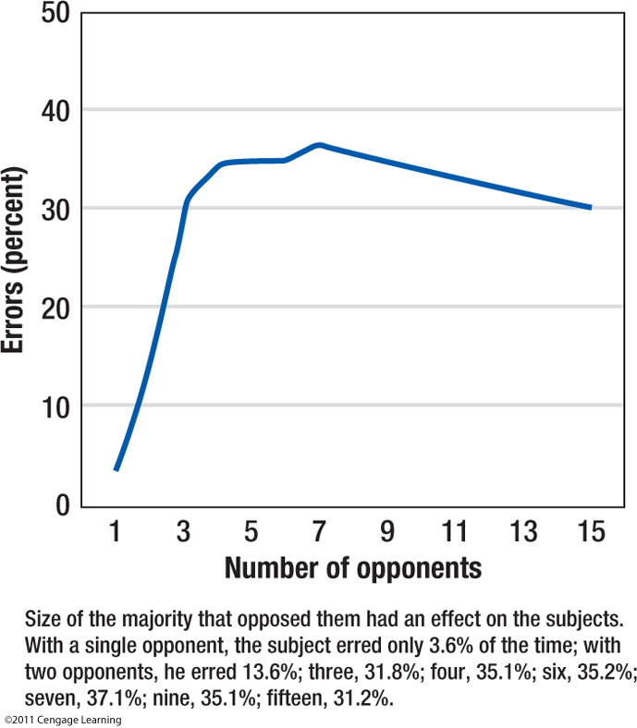
Notes:
Figure 8.1 Effect of group size on conformity in the Asch experiment: As the number of confederates increased from one to four, conformity increased dramatically; as more confederates were added, conformity leveled off.

Slide 5
Informational Social Influence
Going along with the crowd because you believe the crowd knows more than you do
The desire to be right
Strongest in:
Ambiguous situations
Crisis situations
When experts are present
Notes:
Technology Tip: The website Changing Minds presents an accessible overview of informational influence, why it is important, and ways to combat it (http://changingminds.org/explanations/theories/informational_social_influence.htm).
Discussion Tip: Ask students to imagine their first days on campus. In what ways were they influenced by informational social influence? At the cafeteria? In their dorms? In class?

Slide 6
Two Types of Social Influence
Informational influence produces private acceptance
Genuine inner belief that others are right
Normative influence produces public compliance
Inner belief that the group is wrong

Slide 7
Social Influence Principles
Reciprocity
Consistency
Social proof
Authority
Likeability
Scarcity
Robert B. Cialdini, Influence: The Psychology of Persuasion (revised; New York: Quill, 1993)

Slide 8
Social Influence Principles
Reciprocity: we want to repay, in kind, what another person has provided us
Consistency
Social proof
Authority
Likeability
Scarcity
Robert B. Cialdini, Influence: The Psychology of Persuasion (revised; New York: Quill, 1993)

Slide 9
Social Influence Principles
Reciprocity: we want to repay, in kind, what another person has provided us
Consistency: desire to be (and to appear) consistent with what we have already done
Social proof
Authority
Likeability
Scarcity
Robert B. Cialdini, Influence: The Psychology of Persuasion (revised; New York: Quill, 1993)

Slide 10
Social Influence Principles
Reciprocity: we want to repay, in kind, what another person has provided us
Consistency: desire to be (and to appear) consistent with what we have already done
Social proof: to determine what is correct find out what other people think is correct
Authority
Likeability
Scarcity
Robert B. Cialdini, Influence: The Psychology of Persuasion (revised; New York: Quill, 1993)

Slide 11
Social Influence Principles
Reciprocity: we want to repay, in kind, what another person has provided us
Consistency: desire to be (and to appear) consistent with what we have already done
Social proof: to determine what is correct find out what other people think is correct
Authority: deep-seated sense of duty to authority
Likeability
Scarcity
Robert B. Cialdini, Influence: The Psychology of Persuasion (revised; New York: Quill, 1993)

Slide 12
Social Influence Principles
Reciprocity: we want to repay, in kind, what another person has provided us
Consistency: desire to be (and to appear) consistent with what we have already done
Social proof: to determine what is correct find out what other people think is correct
Authority: deep-seated sense of duty to authority
Likeability: we say yes to someone we like
Scarcity
Robert B. Cialdini, Influence: The Psychology of Persuasion (revised; New York: Quill, 1993)

Slide 13
Social Influence Principles
Reciprocity: we want to repay, in kind, what another person has provided us
Consistency: desire to be (and to appear) consistent with what we have already done
Social proof: to determine what is correct find out what other people think is correct
Authority: deep-seated sense of duty to authority
Likeability: we say yes to someone we like
Scarcity: limitation enhances desirability
Robert B. Cialdini, Influence: The Psychology of Persuasion (revised; New York: Quill, 1993)

Slide 14
Social Influence Principles
Reciprocity: we want to repay, in kind, what another person has provided us
Consistency: desire to be (and to appear) consistent with what we have already done
Social proof: to determine what is correct find out what other people think is correct
Authority: deep-seated sense of duty to authority
Likeability: we say yes to someone we like
Scarcity: limitation enhances desirability
Robert B. Cialdini, Influence: The Psychology of Persuasion (revised; New York: Quill, 1993)

Slide 15
Techniques of Social Influence: based on principles of commitment and consistency
Foot-in-the-Door Technique
Start with small request to gain eventual compliance with larger request
Low-ball Technique
Start with low-cost request and later reveal the hidden costs
Notes:
Teaching Tip: Robert Cialdini’s book Influence: Science and Practice presents numerous examples of social influence that you can use with your class (http://changingminds.org/explanations/theories/informational_social_influence.htm).
Technology Tip: A very interesting glimpse inside the mind of someone recruited into a cult-like self-help group is available at CityPages.
Technology Tip: A PBS Frontline episode on marketing is available in its entirety at PBS.org, which also offers discussion groups, interviews, and teacher guides (http://www.pbs.org/wgbh/pages/frontline/shows/persuaders/view/).
Technology Tips: Steve Booth-Butterfield provides examples of the foot-in-the-door and door-in-the-face techniques on his website (http://www.as.wvu.edu/~sbb/comm221/chapters/twosteps.htm).
Technology Tip: A current car financing scam called yo-yo financing is a variation on the low-ball technique. See, for example, the article “Yo-Yo Deals: Stringing Car Buyers Along” at Washingtonpost.com.

Slide 16
Techniques of Social Influence: based on principles of commitment and consistency
Bait-and-Switch Technique
Draw people in with an attractive offer that is not available and then switch to a less attractive offer that is available
Labeling Technique
Assigning a label to an individual and then making a request consistent with that label
Self-Fulfilling prophesy

Slide 17
Techniques of Social Influence: based on principles of commitment and consistency
All of these relate to various theories:
Self-Perception
Cognitive Dissonance
Effort Justification
We have made a commitment in some way and we want to maintain a perception of consistency about ourselves.
Notes:
17

Slide 18
Techniques of Social Influence: based on principles of reciprocity
Social Norm of Reciprocity
Door-in-the-Face Technique
Start with an inflated request and then retreat to a smaller one that appears to be a concession
Does not work if the first request is viewed as unreasonable or if requests are made by different people
That’s-Not-All Technique
Begin with inflated request but immediately add to the deal by offering a bonus or discount

Slide 19
Techniques of Social Influence: based on principles of scarcity
Rare opportunities are more valuable than plentiful ones
Limited-Number Technique
Fast-Approaching Deadline Technique
Scarcity heuristic in decision making
What is rare is good.
Psychological reactance
When personal freedoms are threatened, we experience this unpleasant emotional response
Notes:
Technology Tip: Debra Mashek received a 2006 Action Teaching Tip Award Honorable Mention from the Social Psychology Network for her teaching activity on persuasion. Students use various persuasion techniques to seek aid for victims of Hurricane Katrina. See details at http://socialpsychology.org/awards/action2006hm2.htm.

Slide 20
Techniques of Social Influence: based on principles of Capturing and Disrupting Attention
Strong Arguments – Capture Attention
Weak Arguments – Disrupt Attention
Pique Technique
One captures people’s attention by making a novel request
Disrupt-then-Reframe Technique
Introduce an unexpected element that disrupts critical thinking and then reframe the message in a positive light
Notes:
Technology Tip: A recent television commercial for a product called Head On received much attention for its use of the pique technique. See NBC news report at YouTube.com (http://youtube.com/watch?v=TiAIhHJCtRs)
Teaching Tip: See the JoinIn on TurningPoint CD for an interesting activity regarding pique technique.

Slide 21
Persuasion
Attempt to change a person’s mind
Three components of persuasion
Who – Source of the message
Say What – Actual message
To Whom – Audience
Notes:
Technology Tip: The NBC program Dateline (episode titled “Friendly Persuasion”) varied individuals’ features in various persuasion attempts.

Slide 22
Who: The Source
Source credibility
Expertise
Trustworthiness
Sleeper effect – over time, people separate the message from the messenger
Source likability
Similarity
Physical attractiveness
- Halo effect – Assume other positive qualities

Slide 23
Say What: The Message
Reason Versus Emotion
Facts appeal to intellectual, analytical thinkers.
People in a good mood – more responsive to persuasive messages
Humor and Moderate fear have been shown to be persuasive
Notes:
Technology Tip: Using humor to reduce audience fear is highlighted in “Terminix Keeps Ads Light So They Don’t Creep Out Customers,” available at USAToday.com.

Slide 24
Say What: The Message
Stealing Thunder
Revealing potentially incriminating evidence to negate its importance
Source appears more honest and credible
Two-Sided Argument
More effective, especially for intelligent, thoughtful audience

Slide 25
Say What: The Message
Repetition
If neutral or positive response initially, repeated exposure = persuasive message
Repetition with variety
Advertisement wear-out
is a “condition of inattention and possible irritation that occurs after an audience or target market has encountered a specific advertisement too many times”

Slide 26
To Whom: The Audience
Moderately intelligent are easiest to persuade
People high in need for cognition are more persuaded by strong arguments
Attitudes are more resistant to change
People high in public self-consciousness are more persuaded by name brand and styles

Slide 27
To Whom: The Audience
Impressionable years hypothesis
Middle-aged people most resistant to persuasion
Attitudes formed in young adulthood remain fairly stable over time
Messages consistent with cultural values are more persuasive

Slide 28
To Whom: The Audience
“Overheard” messages are more persuasive
Product placements
Distraction
Effective if the message is weak
Less effective with a strong message
Notes:
Discussion Tip: Ask students whether they think the Head On commercial (http://youtube.com/watch?v=Is3icfcbmbs) is a “good” ad. Ask them to justify their beliefs based on research on persuasion.

Slide 29
Two Routes to Persuasion
Elaboration likelihood model
Heuristic/Systematic model
Both propose automatic and conscious processing are involved in persuasion

Slide 30
Two Routes to Persuasion
Central route
Involves conscious processing
Careful and thoughtful consideration
Peripheral route
Involves automatic processing
Influenced by some simple cue

Slide 31
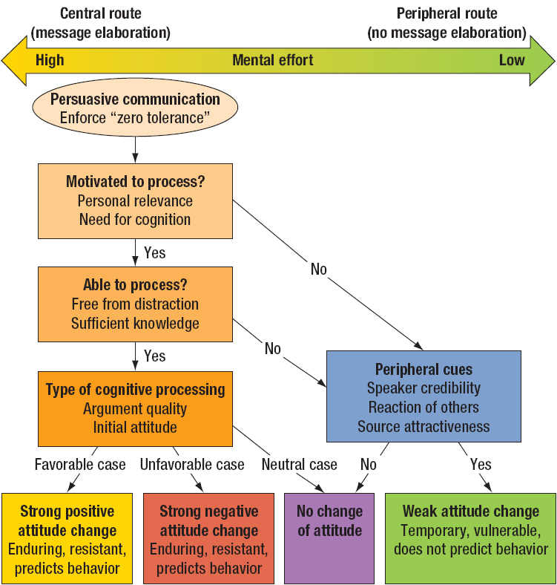
Notes:
Figure 8.3 Elaboration likelihood model (ELM) of persuasion

Slide 32
Elaboration Likelihood Model
Motivation to process message
Personal relevance
Need for cognition
Ability to process
Distractions
Knowledge
Notes:
Teaching Tip: Ask students to located good examples of print advertisements using either the central route or the peripheral route to persuasion. What features of the ad make it central of peripheral? For whom will the ad be successful, and for how long?

Slide 33
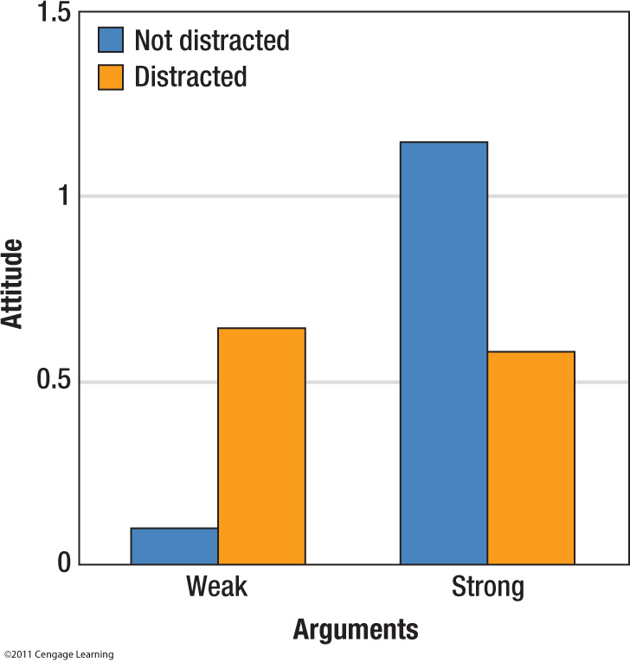
Notes:
Figure 8.4 Distraction decreases our ability to think about a persuasive message. When the message arguments are weak, distraction increases the persuasiveness of the message. When the message arguments are strong, distraction decreases the persuasiveness of the message (Tsal, 1984; cited in Petty & Cacioppo, 1986).

Slide 34
Elaboration Likelihood Model
Type of cognitive processing
Quality of the arguments
Initial attitude
Peripheral cues
Speaker credibility
Reaction of others
External rewards
Notes:
Technology Tip: A collection of award-winning television ads is available at adawards.com

Slide 35
Alpha and Omega Strategies
Alpha strategies
Persuade by increasing approach forces
Omega strategies
Persuade by decreasing avoidance forces
When approach forces are greater than avoidance forces – movement toward goal

Slide 36
Alpha Strategies
Make messages more persuasive
Strong arguments that compel action
Add incentives
Increase source credibility
Provide consensus information
Notes:
Teaching Tip: Television shopping networks’ use of counters to indicate how many people have purchased the product are an example of normative influence.

Slide 37
Resisting Persuasion
Attitude Inoculation
When people resist persuasion, they become more confident in their initial attitudes
Advance warning of a persuasive message
Negative attitude change
Boomerang effect
Stockpile resources

Slide 38
Defenses Against Techniques
Commitment and Consistency
Reexamine the sense of obligation
Reciprocation
Evaluate favors or concessions to avoid guilt over lack of reciprocity

Slide 39
Defenses Against Techniques
Scarcity
Recognize psychological reactance as a signal to think rationally
Evaluate the reason we want the item
Capturing and Disrupting Attention
Stop and think before action
Social Proof
Recognize ‘fake’ social proofs

