Slide 1
Chapter 8
Psychosocial Development during the First Three Years

Slide 2
Foundations of Psychosocial Development
Psychosocial development - Combination of individual development with social relationships.
Emotions
Personality
Temperament
Attachment
Sense of Self

Slide 3
Emotions
Subjective reactions to experience that are associated with physiological and behavioral changes.
Develop during infancy and are a basic element of personality.
Culture influences the way people:
Feel about a situation
Show their emotions

Slide 4
First Signs of Emotion
Crying
Most powerful way infants can communicate their needs
Patterns - Hunger, anger, pain, and frustration cries
Smiling and laughing
Social smiling - When newborn infants gaze at their parents and smile at them
Laughter - Smile-linked vocalization

Slide 5
Emotional Development
Emotional development is an orderly process.
Complex emotions unfold from simpler ones.
Babies show signs of contentment, interest, and distress soon after birth.
Self-conscious emotions: Depend on self-awareness.
Embarrassment
Empathy
Envy

Slide 6
Self-Awareness and Emotions
Self-awareness
Realization that one’s existence and functioning are separate from those of other people and things.
Necessary before children can:
Be aware of being the focus of attention
Identify with what others are feeling
Wish they had what someone else has

Slide 7
Self-Awareness and Emotions
Self-evaluative emotions:
Depend on both self-awareness and knowledge of socially accepted standards of behavior.
Pride
Shame
Guilt

Slide 8
Brain Growth and Emotional Development
Development of the brain after birth is closely connected with changes in emotional life.
Bidirectional process - Emotional experiences
Are affected by brain development
Have long-lasting effects on the structure of the brain

Slide 9
Brain Growth and Emotional Development
First shift - First 3 months
Differentiation of basic emotions begins.
Cerebral cortex becomes functional, bringing cognitive perceptions into play.
Second shift - 9 or 10 months
Frontal lobes begin to interact with the limbic system.
Seat of emotional reactions
Hippocampus become larger and more adult-like.
Connections between the frontal cortex and the hypothalamus and limbic system may facilitate the relationship between the cognitive and emotional spheres.

Slide 10
Brain Growth and Emotional Development
Third shift - 2nd year
Infants develop:
Self-awareness
Self-conscious emotions
Greater capacity for regulating their emotions and activities
Fourth shift – 3rd year
Hormonal changes in the autonomic nervous system coincide with the emergence of evaluative emotions.
Sympathetic system - Part of the autonomic system that prepares the body for action.
Parasympathetic system - Part of the autonomic system that is involved in excretion and sexual excitation.

Slide 11
Altruistic Helping, Empathy, and Social Cognition
Altruistic behavior: Activity intended to help another person with no expectation of reward.
Comes naturally to toddlers
Rewarding such behavior tends to undermine it
Empathy: Ability to put oneself in another person’s place and feel what the other person feels.
Social evaluation - Valuing someone on the basis of that person’s treatment of others.

Slide 12
Altruistic Helping, Empathy, and Social Cognition
Mirror neurons:
Fire when a person does something or observes someone else doing the same thing.
Have been linked to imitative learning and to the emergence of:
Self-awareness
Language
Abstract reasoning

Slide 13
Altruistic Helping, Empathy, and Social Cognition
Empathy depends on social cognition.
Social cognition: Ability to understand that other people have mental states and to gauge their feelings and intentions.
Egocentrism: Inability to consider another person’s point of view.
Characteristic of young children’s thought.

Slide 14
Temperament
An individual’s behavioral style and characteristic way of emotionally responding.
Chess & Thomas: 3 basic types (clusters)
Easy child : Positive mood, easily adapts
Difficult child: Resists change, shows irregular behaviors, reacts negatively (cries)
Slow-to-warm child: Low mood intensity, low activity level, somewhat negative

Slide 15
How Stable Is Temperament?
Newborn babies show different patterns of sleeping, fussing, and activity.
Appears to be largely inborn.
Develops as various emotions and self-regulatory capacities appear.
Can change in response to parental treatment and other life experiences.

Slide 16
Temperament and Adjustment
Goodness of fit:
Appropriateness of environmental demands and constraints to a child’s temperament.
Child-caregiver relationship
The fit between the child and the wider social context

Slide 17
Shyness and Boldness
Influences of biology and culture
Behavioral inhibition - How boldly or cautiously a child approaches unfamiliar objects and situations.
Associated with certain biological characteristics
Most clearly seen when babies are presented with novel stimuli
Environmental influences

Slide 18
Trust
Trust versus mistrust:
Erikson’s first stage in psychosocial development
Infants develop a sense of the reliability of people and objects.

Slide 19
Attachment
Attachment:
Reciprocal, enduring tie between infant and caregiver, each of whom contributes to the quality of the relationship.
Have adaptive value for babies, ensuring that their psychosocial as well as physical needs will be met

Slide 20
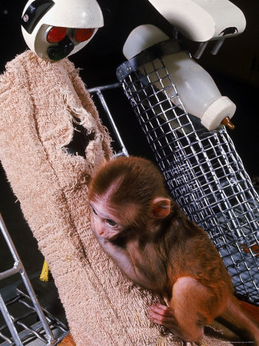
Theories of Attachment
Cognitive View of Attachment
Infant must develop object permanence prior to forming attachment
Behavioral View of Attachment
Caregiver becomes a conditioned reinforcer
Psychoanalytic Views of Attachment
Caregiver satisfies infant’s needs
(food – trust)
Harlows’ View of Attachment
Contact comfort is key to attachment
Notes:
Technology Tip: Have students watch this YouTube video (or similar videos) that demonstrate the classic contact comfort study. Discuss in class.
URL: http://www.youtube.com/watch?v=KlfOecrr6kI
Teaching Tip: Parenting & Family Studies: Have students discuss ways in which parents use clothing, blankets, and toys to provide contact comfort for their infants.

Slide 21
How Attachment Is Established
Ethology’s View of Attachment
Bowlby’s concept
Adults and children are predisposed to attach.
Attachment styles are the result of expectations formed because of repeated interactions with a caregiver.
Sets of expectations - Working models
Early working models became the blueprint for the dynamics of the relationship.

Slide 22
Individual Differences in Attachment
Ainsworth’s Strange Situation
Measures attachment by observation; Infant experiences series of contexts
Reactions to new situation
Secure: Positive, confident exploration
Insecure-avoidant: Little interaction with caregiver, no distress
Insecure-resistant: Clings to caregiver
Insecure disorganized: Disoriented, dazed

Slide 23
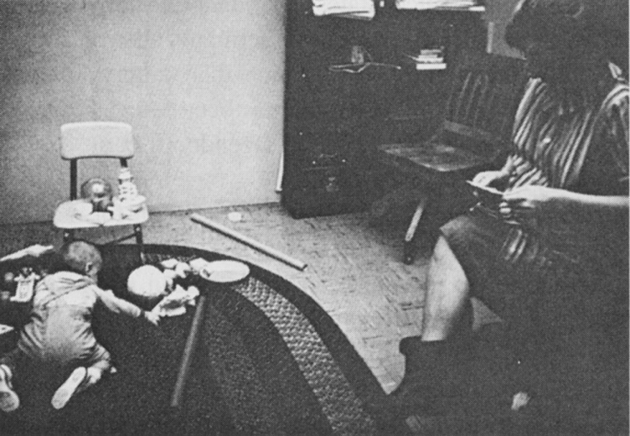
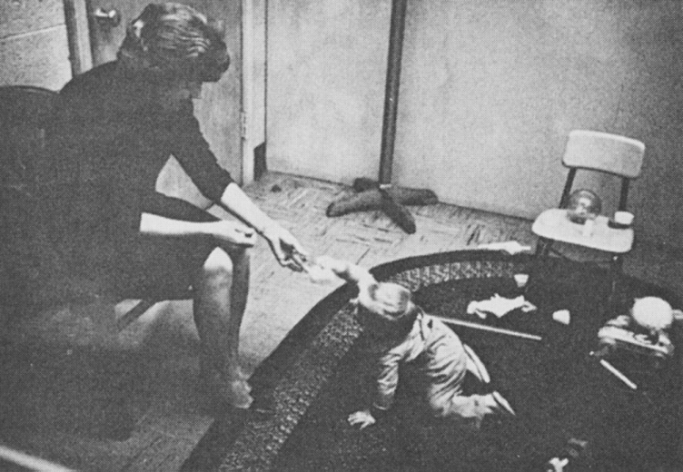
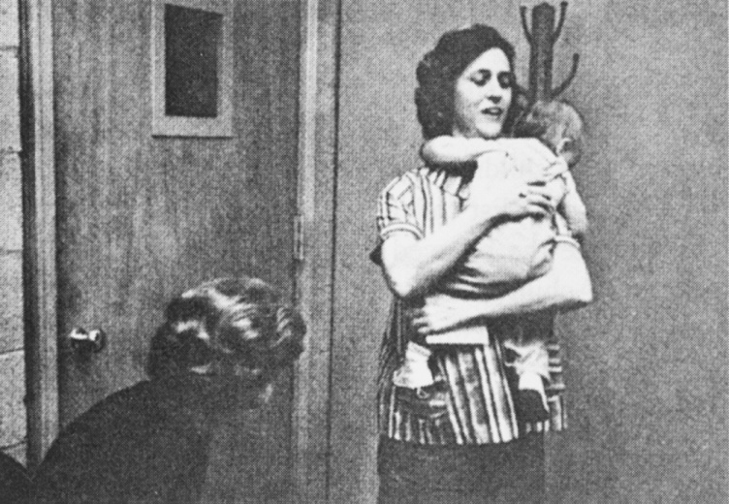
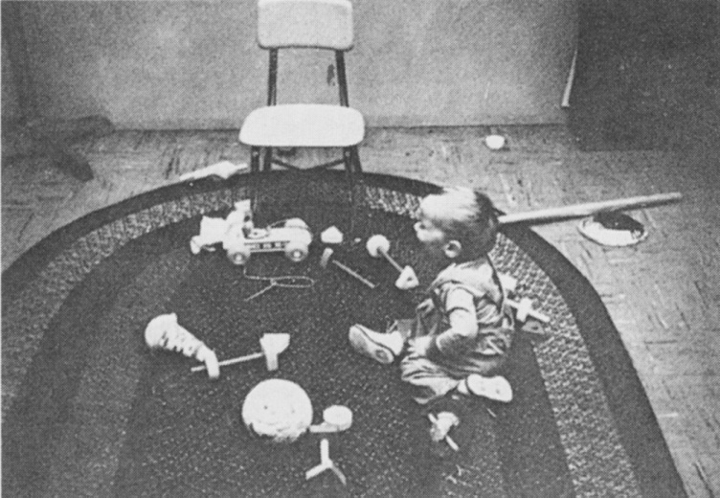
The Strange Situation
Notes:
Figure 7.1 The Strange Situation. These historic photos show a 12-month-old child in the strange situation. In (a), the child plays with toys, glancing occasionally at mother. In (b), the stranger approaches with a toy. While the child is distracted, mother leaves the room. In (c), mother returns after a brief absence. The child crawls to her quickly and clings to her when picked up. In (d), the child cries when mother again leave the room. What pattern of attachment is this child showing?

Slide 24
Role of Temperament
Neurological or physiological conditions may underlie temperament differences in attachment.
Baby’s temperament has:
Direct impact on attachment
Indirect impact through its effect on the parents
Goodness of fit may be a key to understanding security of attachment.

Slide 25
Long-Term Effects of Attachment
Securely Attached Toddlers
Insecurely Attached Toddlers
Have more varied vocabularies
Have a positive self-image
Have curiosity, competency, empathy, and self-confidence
Have the closest, most stable friendships
Show more fear, distress, and anger
Have inhibitions and negative emotions in toddlerhood
Have hostility toward other children at age 5
Have dependency during the school years

Slide 26
Emotional Communication with Caregivers
Bidirectional communication and interactions
Mutual regulation: Process by which infant and caregiver communicate emotional states to each other and respond appropriately.
Social referencing: Understanding an ambiguous situation by seeking out another person’s perception of it.

Slide 27
Emerging Sense of Self
Self-concept
Sense of self
Descriptive and evaluative mental picture of one’s abilities and traits
Personal agency
Realization that infants can control their external events
Self-coherence
Sense of being a physical whole with boundaries separate from the world
Self-representation
Conscious knowledge of the self as a distinct, identifiable being

Slide 28
Developing Autonomy
Autonomy versus shame and doubt: Children achieve a balance between self-determination and control by others.
Erikson’s second stage in psychosocial development.
Negativism - Tendency to shout “no” just for the sake of resisting authority.

Slide 30
Developing Self-Regulation
Self-regulation:
Independent control of behavior of a person to conform to understood social expectations.
Foundation of socialization
Links all domains of development
Physical
Cognitive
Social
Emotional

Slide 31
Developing Self-Regulation
Attentional regulation enables children to develop willpower and cope with frustration.
Parallels the development of the self-conscious and evaluative emotions.
Requires the ability to wait for gratification.
Correlated with measures of conscience development.

Slide 32
Origins of Conscience
Conscience: Internal standards of behavior.
Controls one’s conduct
Produces emotional discomfort when violated
Grazyna Kochanska’s longitudinal study of origins of conscience
Situational compliance: Obedience of a parent’s orders only in the presence of signs of ongoing parental control.

Slide 33
Origins of Conscience
Committed compliance: Wholehearted obedience of a parent’s orders without reminders or lapses.
Receptive cooperation: Eager willingness to cooperate harmoniously with a parent in daily interactions.

Slide 34
Factors in the Success of Socialization
Security of attachment
Fosters committed compliance and conscience development
Observational learning from parents’ behavior
Mutual responsiveness of parent and child

Slide 35
Factors in the Success of Socialization
Constructive conflict over a child’s misbehavior
Helps children develop moral understanding by enabling them to see another point of view
Leads to conscience development

Slide 36
Gender Differences in Infants and Toddlers
Infants begin to perceive differences between males and females quite early.
Boys
Girls
Longer, heavier, and slightly stronger
Physically more vulnerable from conception on
Beginning prenatally, more active
Brains at birth are about 10% larger, continues in adulthood
At 17 months - Tend to play more aggressively
Less reactive to stress
More likely to survive infancy
Faster to develop the sense of gender identification

Slide 37
How Parents Shape Gender Differences
Parents influence boys’ and girls’ personalities very early.
Fathers treat boys and girls more differently than mothers do.
Gender-typing: Socialization process by which children learn appropriate gender roles.
Differ by culture

Slide 38
Siblings Relationships
Begin with the birth of a new baby in a household
Continue to develop throughout childhood
Both positively and negatively
Arrival of a new baby
Variation in children’s adjustment to a new baby
Older child’s age
Quality of his or her relationship with the mother
Family atmosphere

Slide 39
Siblings Relationships
Interaction
Sibling conflicts can become a mode for understanding social relationships.
Rivalry may be present, and so is affection.
As cognitive and social understanding grows:
Sibling conflict tends to become more constructive.
Younger sibling participates in attempts to reconcile.

Slide 40
Sociability with Nonsiblings
Toddlers learn by imitating one another.
Cooperative activity develops during the 2nd and 3rd years as social understanding grows.
Affected by temperamental traits and experience

Slide 41
Effects of Maternal Employment
Negative effects on cognitive development at 15 months to 3 years.
Maternal sensitivity and high-quality child care lessened negative effects.

Slide 42
Factors Affecting Early Child Care
Temperament and gender
Quality of care
Affects cognitive and psychosocial development
Measured by:
Structural characteristics
Process characteristics
Developmental appropriateness of activities

Slide 43
NICHD Study: Isolating Child Care Effects
Child care arrangements varied widely in type and quality.
Child care has no direct effect on attachment.
Independent effects of child care was in interactions with peers.
Quality, quantity, stability, and type of care have some influence on psychosocial and cognitive development.

