Slide 1
Chapter 5
Birth and the Newborn Baby

Slide 2
How Birthing Has Changed
Prior to the 20th century, birth was a female social ritual.
Home deliveries and midwives
Reducing the risks of childbirth
Growing use of maternity hospitals
Antibiotics and safe anesthesia
Improved hygiene and drugs for inducing labor
Blood transfusion and better prenatal assessment

Slide 3
Contemporary Settings for Childbirth
Hospital birth has become a surgical act.
Home births with trained nurse-midwives
Homelike birth centers
Demedicalizing birthing experience
Rooming-in policies

Slide 4
The Birth Process
Parturition: Process of giving birth.
Begins about two weeks before delivery.
Determined by increase in the rate of production of corticotropin-releasing hormone.
Uterine, cervical, and other changes occur.
False contractions may occur.

Slide 5
Stages of Childbirth
Labor
Birth
Afterbirth
Lasts 12 to 24 hours
Regular and increasingly uterine contractions
Stage lasts until the cervix is fully open
Lasts 1 to 2 hours
Baby’s head begins to move through the cervix into the vaginal canal
Baby completely emerges out
Lasts 10 minutes to 1 hour
Placenta and the remainder of the umbilical cord are expelled

Slide 6
Electronic Fetal Monitoring
Tracks the fetus’s heartbeat during labor and delivery.
Indicates how the fetal heart is responding to the stress of uterine contractions.
Provides valuable information in high-risk deliveries.
Drawbacks
Costly
Restricts the mother’s movements during labor.
Has an extremely high false-positive rate.

Slide 7
Vaginal Versus Cesarean Delivery
Vaginal delivery is the usual method.
Cesarean delivery: Surgically removing the baby from the uterus.
Labor progresses too slowly
Fetus seems to be in trouble
Vaginal bleeding
Breech or transverse position of fetus
Head is too big to pass through the mother’s pelvis

Slide 8
Disadvantages of Cesarean Delivery
Mother
Baby
Bleeding
Infection
Damage to pelvic organs
Postoperative pain
Risks of problems in future pregnancies
Deprives the baby of hormones that:
Clear the lungs of excess fluid
Mobilize stored fuel to nourish cells
Send blood to the heart and brain

Slide 9
Medicated Versus Nonmedicated Delivery
Natural, or prepared, childbirth: Method of childbirth that seeks to:
Reduce or eliminate the use of drugs
Enable both parents to participate fully
Control perceptions of pain
Doula: Experienced mentor who furnishes emotional support and information for a woman during labor.

Slide 10
Medicated Versus Nonmedicated Delivery
Natural childbirth
Medicated childbirth
Lamaze method
Water births
Bradley method
Local
Pedunal block
Analgesic
Regional
Epidural or spinal

Slide 11
The Newborn Baby
Neonatal period: Transition from the uterus to an independent existence.
Size and appearance
Neonates: Newborn baby, up to 4 weeks old
Are 7 ½ pounds and 20 inches long
Have large head, ¼ the body length
Have red skin, birthmarks, and receding chin

Slide 12
Distinctive Features of Neonates
Newborns have:
Fontanels - Soft spots where the bones of the skull do not meet.
Lead to misshapen head
Lanugo - Fuzzy prenatal hair on the shoulders, has not yet fallen off.
Vernix caseosa - Formed in the womb by secretions from the fetal oil glands.
Protects against infection

Slide 13
Body Systems
The baby’s systems and functions operate on their own after birth.
Most of this transition occurs during the first 4 to 6 hours after delivery.

Slide 14
Body Systems
Most babies begin breathing soon after they are exposed to air.
Anoxia: Lack of oxygen
Hypoxia - Reduced oxygen supply
Babies are born alert and ready to begin feeding.
Have a strong sucking reflex to take in milk.
Have gastrointestinal secretions to digest.

Slide 15
Body Systems
Babies eliminate toxins from their bodies independently.
Meconium - Stringy, greenish-black waste matter formed in the intestinal tract.
Babies begin to urinate on a regular basis.
Volume of urine is proportionate to food intake.
Sphincter muscles open automatically when bowel and bladder is full.

Slide 16
Body Systems
Body temperature is kept constant by layers of fat that develop during the last 2 months of fetal life.
Neonatal jaundice: Skin and eyeballs look yellow.
Develops 3 to 4 days after birth.
Caused by the immaturity of the liver and failure to filter out bilirubin.

Slide 17
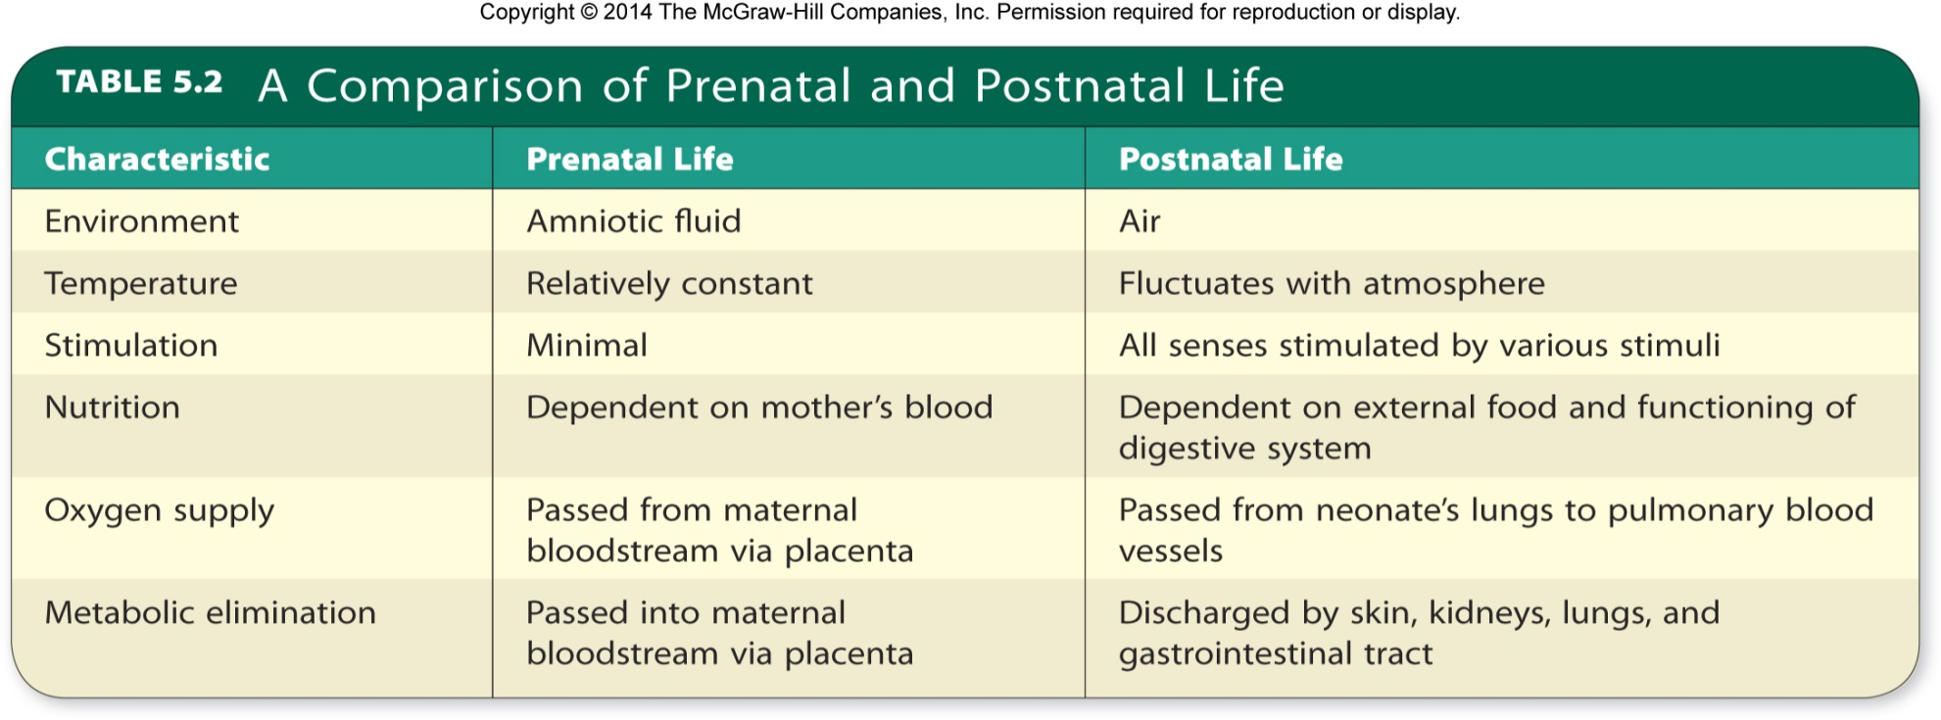
Table 5.2 - A Comparison of Prenatal and Postnatal Life

Slide 18
Medical and Behavioral Assessment
After delivery, most babies are assessed using the Apgar scale:
Appearance - Color
Pulse - Heart rate
Grimace - Reflex irritability
Activity - Muscle tone
Respiration - Breathing

Slide 19
Brazelton Neonatal Behavioral Assessment Scale
Neurological and behavioral test
Measures neonate’s responses to the environment
Motor organization
Reflexes
State changes
Attention and interactive capacities
Central nervous system instability

Slide 20
Neonatal Screening for Medical Conditions
Can detect correctible defects
Enzyme disorder phenylketonuria
Congenital hypothyroidism
Galactosemia
Expensive

Slide 21
States of Arousal and Activity Levels
State of arousal: Infant’s physiological and behavioral status at a given moment in the periodic daily cycle of wakefulness, sleep, and activity.
Is inborn and governs periodic cycles of activity.
Newborns alternate between quiet and active sleep.
Active sleep appears to be the equivalent of rapid eye movement sleep.

Slide 22
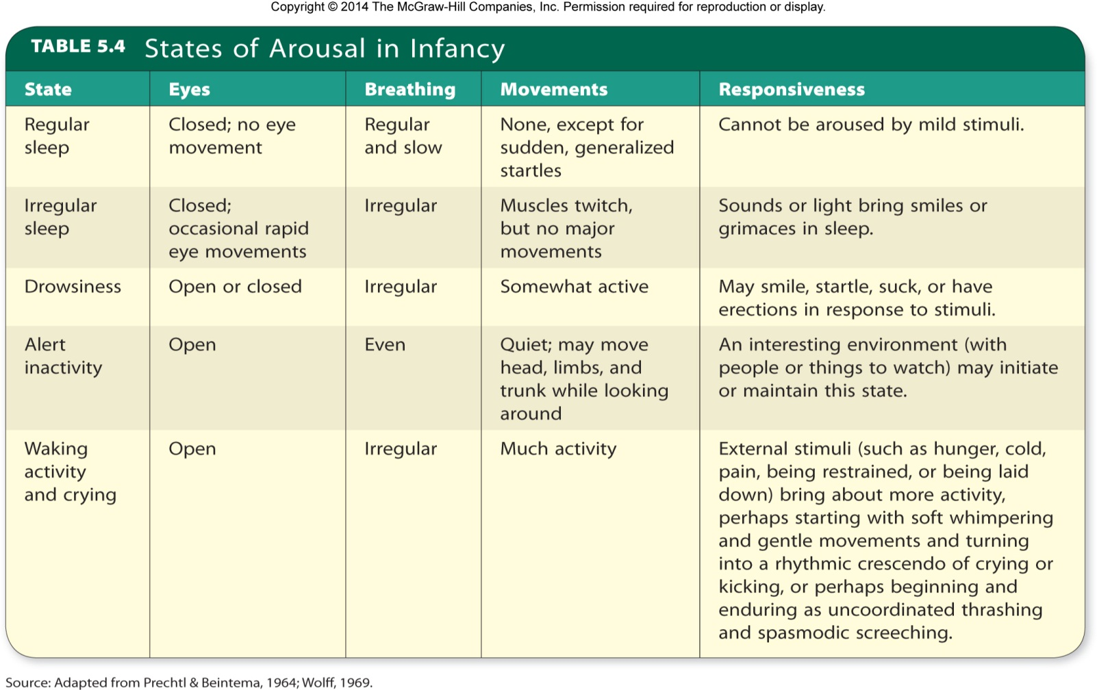
Table 5.4 - States of Arousal in Infancy

Slide 23
Complications of Childbirth and Their Aftermath
Low birth weight babies: Neonates born weighing less than 2,500 grams at birth.
Preterm infants: Born before the 37th week of gestation.
Small-for-date infants: Infants whose birth weight is less than that of 90 percent of babies of the same gestational age as a result of slow fetal growth.

Slide 24
Factors Contributing to Low Birth Weight Babies
Demographic and socioeconomic factors
Medical factors predating the pregnancy
Prenatal behavioral and environmental factors
Medical conditions associated with the pregnancy

Slide 25
Low Birth Weight
Immediate treatment
Feeding intravenously
Feeding mothers’ milk can help prevent infection
Placing infant in an isolette
Kangaroo care: Skin-to-skin contact in which a newborn is laid face down between the mother’s breasts.
Administering surfactant

Slide 26
Low Birth Weight
Long-term outcomes
Increased risk of:
Adult-onset diabetes
Cardiovascular disease
Impaired mental development
Due to lack of Docosahexaenoic acid

Slide 27
Low Birth Weight
Problems that can be:
Neurological
Sensory
Cognitive
Educational
Behavioral
Lower IQs

Slide 28
Postmaturity
Fetus not yet born as of 42 weeks’ gestation.
Tend to be long and thin
Complicates labor
Risk of brain damage or death
Induction of labor as fetuses are in danger of brain damage or death.

Slide 29
Stillbirth
Death of a fetus at or after the 20th week of gestation.
Cause is not clear.
Small fetuses indicate malnourishment.
Women over age 35 or under age 20 have higher risk.

Slide 30
Supportive Environment and Birth Complications
Appropriate environmental characteristics can help an infant develop optimally.
Kauai Study
Protective factors: Factors that reduce the impact of potentially negative influences and tend to predict positive outcomes.
Individual attributes
Affectionate ties
Rewards

Slide 31
Childbirth and Bonding
Mother-infant bond: Close, caring connection between mother and newborn.
Ethological approach
Behavior in human beings is biologically influenced.
Emphasizes critical or sensitive periods for development of certain behaviors.
Imprinting: During a critical period in early development, a young animal forms an attachment to the first moving object it sees.
Infants develop attachment figures over a span of time.

Slide 32
Childbirth and Bonding
Fathers form close bonds with their babies.
Involved fathers show decreases in testosterone levels over the course of a pregnancy.
Suggesting their bodies’ physiology is preparing them for parenting behaviors.
Impacted by the quality of the relationship between the mother and father.

Slide 33
What Do Newborns Need from Their Mothers?
Feeding is not the most important thing babies get from their mothers.
Harry Harlow’s experiment
Mothering includes:
Comfort of close bodily contact
Satisfaction of an innate need to cling

Slide 34
Father’s Role
Differs by culture
Father’s frequent and positive involvement with his child is directly related to the child’s:
Well-being and physical
Cognitive and social development

Slide 35
How Parenthood Affects Marital Satisfaction
Marital satisfaction declines during the child-raising years.
Causes
Multiple stressors affecting their health and state of mind
Feeling of isolation

Slide 36
How Parenthood Affects Marital Satisfaction
Satisfaction depends on:
Planned pregnancy
Unplanned pregnancy
Attending counseling sessions from the last trimester of the pregnancy

