Slide 1
Chapter 3
Forming A New Life: Conception, Heredity, and Environment

Slide 2
How Fertilization Takes Place
Fertilization
Union of sperm and ovum to produce a zygote.
Also called conception
Zygote:
One-celled organism resulting from fertilization.
Duplicates itself by cell division to create a baby

Slide 3
How Fertilization Takes Place
Women
At birth, have 2 million ova in their ovaries, each contained in a follicle.
During ovulation, when sexual maturity is attained, a mature follicle is ruptured and the ovum is expelled from the ovary.

Slide 4
How Fertilization Takes Place
Men
Several hundred million sperm are produced in the testicles each day.
Sperm enter the vagina through ejaculation and attempt to reach the cervix.
Few will arrive in the fallopian tubes where fertilization takes place.

Slide 5
Infertility
Inability to conceive a baby after 12 months of trying.
Women’s fertility begins to decline in the late 20s.
Men’s fertility begins to decline in the late 30s.

Slide 6
Table 3.1 - Common Causes of Infertility in Men and Women

Slide 7
Table 3.1 - Common Causes of Infertility in Men and Women

Slide 8
Treatments for Infertility
Hormone Treatment
Drug Therapy
Surgery

Slide 9
Alternative Ways to Parenthood
In vitro fertilization (IVF) - Increases the likelihood of multiple, usually premature, births.
In vitro maturation (IVM) - Diminishes the likelihood of multiple births.
Performed earlier in the monthly cycle
Makes hormone injections unnecessary

Slide 10
Alternative Ways to Parenthood
Male infertility
Intracytoplasmic sperm injection (ICSI)
Artificial insemination
Artificial insemination by a donor (AID)
Gamete intrafallopian transfer (GIFT)
Zygote intrafallopian transfer (ZIFT)
Surrogate motherhood
Surrogate - Fertile woman impregnated by a prospective father by artificial insemination.

Slide 11
Mechanisms of Heredity
Heredity
Genetic transmission of heritable characteristics from parents to offspring.
Genetic code
Sequence of bases within the DNA molecule.
Set of rules that govern the formation of proteins that determine the structure and functions of living cells.

Slide 12
Genetic Code
Chromosomes: Coils of DNA that consist of genes.
Genes: Small segments of DNA located in definite positions on particular chromosomes.
Functional units of heredity
Located in a definite position on chromosome
Human genome: Complete sequence of genes in the human body.

Slide 13
Cell Division
Meiosis
Type of cell division which the sex cells undergo when they are developing.
Crossing Over
Each sex cell ends up with only 23 chromosomes.
Mitosis
Process by which the nonsex cells divide in half over and over again.
DNA replicates itself, so that each newly formed cell has the same DNA structure as all the others.

Slide 14
Genotypes and Phenotypes
Phenotype: Observable characteristics of a person.
Genotype: Genetic makeup of a person, containing both expressed and unexpressed characteristics.

Slide 15
Patterns of Genetic Transmission
Dominant and recessive inheritance
Every offspring gets a pair of alleles for each characteristic, one from each parent.
Alleles: Two or more alternative forms of a gene that can occupy the same position on paired chromosomes and affect the same trait.
Homozygous: Possessing two identical alleles for a trait.
Heterozygous: Possessing differing alleles for a trait.

Slide 16
Patterns of Genetic Transmission
Polygenic inheritance
Pattern of inheritance in which multiple genes at different sites on chromosomes affect a complex trait.
Multifactorial transmission
Combination of genetic and environmental factors to produce certain complex traits.
Traits may also be affected by mutations.
Mutations: Permanent alterations in genes or chromosomes

Slide 17
Genetic Birth Defects
Dominant traits
Achondroplasia - Type of dwarfism
Huntington’s disease

Slide 18
Genetic Disorders
Huntington’s disease
Sickle-cell anemia - Can be incomplete dominance
PKU - Phenylketonuria

Slide 19
Dominant or Recessive Inheritance of Defects
Dominant traits
Achondroplasia - Type of dwarfism
Huntington’s disease
Recessive traits
Tay-Sachs
PKU
Sickle-cell anemia - Can be incomplete dominance
Incomplete dominance: Pattern of inheritance in which a child receives two different alleles, resulting in partial expression of a trait.

Slide 20
Sex-Linked Inheritance of Defects
Sex-linked inheritance: Pattern of inheritance in which certain characteristics carried on the X chromosome inherited from the mother are transmitted differently to her male and female offspring.
Certain recessive disorders are linked to genes on the sex chromosomes.
Male and female children affected differently.
Carriers - Heterozygote females who carry one bad copy of a recessive gene and one good one.

Slide 21
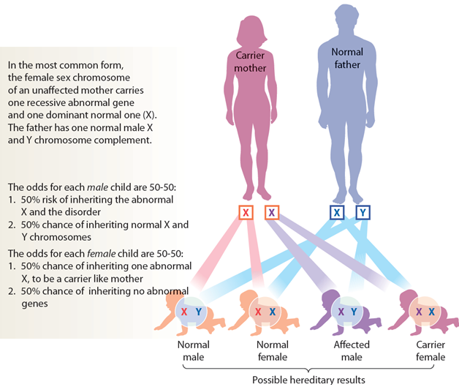
Figure 3.3 - Genetic and Chromosomal Abnormalities

Slide 22
Chromosomal Abnormalities
Errors in cell division
Extra or missing chromosome
Disorders:
Klinefelter syndrome XXY
Turner syndrome XO
Down syndrome

Slide 23
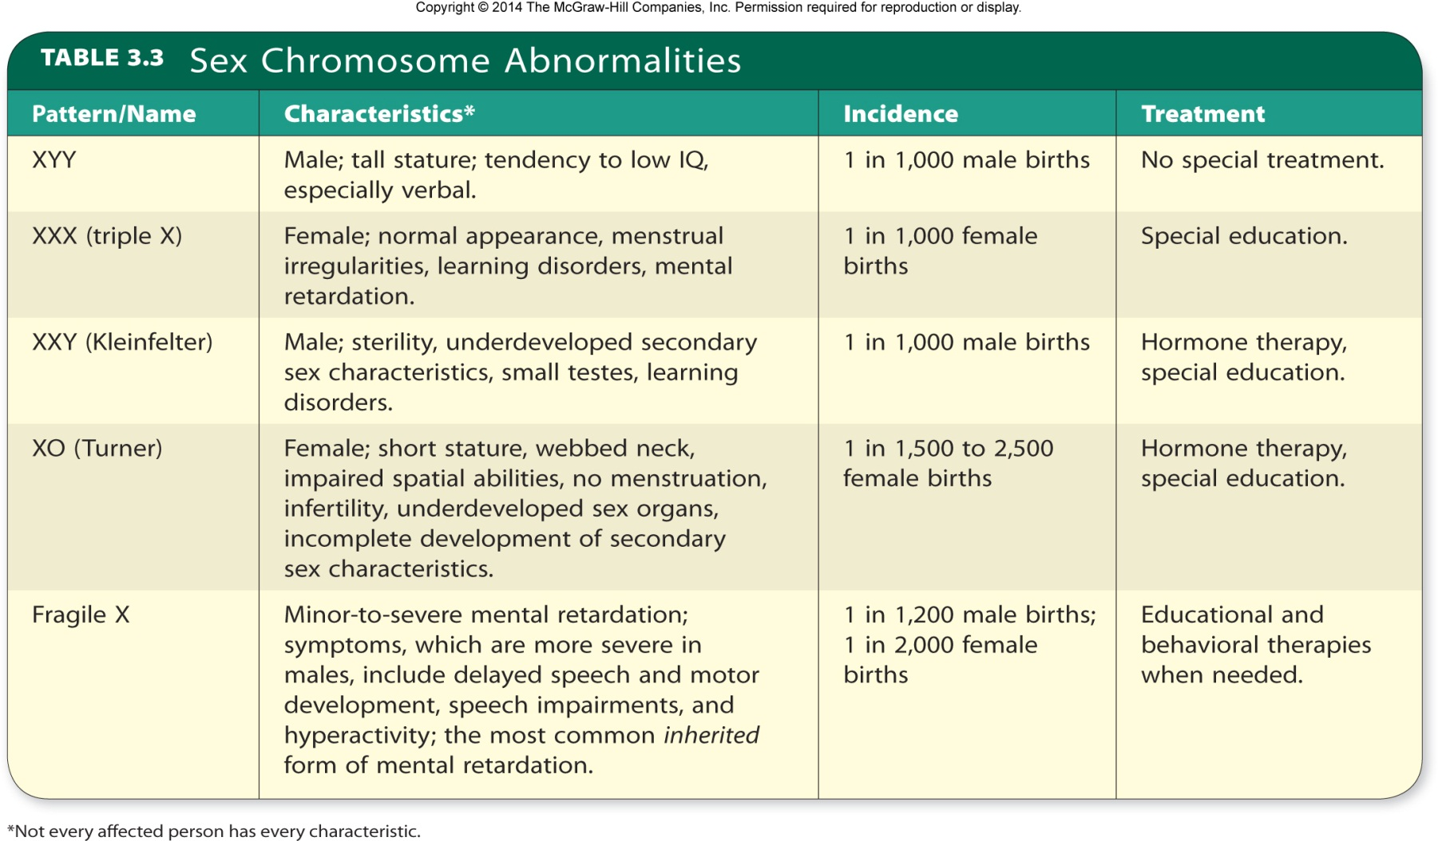
Table 3.3 - Genetic and Chromosomal Abnormalities

Slide 24
Relative Influences of Heredity and Environment
Behavioral genetics: Quantitative study of relative hereditary and environmental influences on behavior.
Heritability: Statistical estimate of contribution of heredity to individual differences in a specific trait within a given population at a particular time.

Slide 25
Genotype-Environment Reaction
Genotype-environment interaction: Effect of the interaction between genes and the environment on phenotypic variation.
Genotype-environment correlation: Tendency of certain genetic and environmental influences to reinforce each other; may be passive, reactive (evocative), or active.
Also called genotype-environment covariance
Genetically similar children often develop differently depending on their home environments.

Slide 26
Genotype-Environment Reaction
Passive
Parents, who provide the genes that predispose a child toward a trait, also tend to provide an environment that encourages the development of that trait.
Reactive or evocative
Children with differing genetic makeups evoke different responses from adults.
Active
As children grow older, they select experiences consistent with their genetic tendencies.
Niche picking - Tendency to seek out environments compatible with one’s genotype.

Slide 27
Reaction Range and Canalization
Reaction Range: Potential variability, depending on environmental conditions, in the expression of a hereditary trait.
Canalization: Limitation on variance of expression of certain inherited characteristics.
Highly canalized traits - Eye color, for example, strongly programmed by genes with little opportunity for variance in their expression.
Cognition and personality are not highly canalized.

Slide 28
Nonshared Environment
Nonshared environmental effects: Unique environment in which each child grows up, consisting of distinctive influences or influences that affect one child differently from another.
Effects of experience on development
Interactions of parenting
Nonfamilial influences
Broader context in which families live

