Slide 1
Chapter 11
Psychosocial Development in Early Childhood

Slide 2
Self-Concept
Self-concept and cognitive development
Self-concept: Sense of self, descriptive and evaluative mental picture of one’s abilities and traits.
Called cognitive construction
Comes into focus in toddlerhood

Slide 3
Self-Definition and Single Representation
Self-definition: Cluster of characteristics used to describe oneself.
Becomes more comprehensive as child ages
Single representations: Preschool children describe themselves in terms of individual, unconnected characteristics and all-or-nothing terms.
Real self: Self one actually is.
Ideal self: Self one would like to be.

Slide 4
Self-Concept Development
Representational systems: School age children develop a broad, inclusive self-concepts that integrate various aspects of the self.
Real self
Ideal self
Global self-worth

Slide 5
Gender
Gender identity: Awareness that one is male or female.
Develops in early childhood
Gender differences - Psychological or behavioral differences between males and females.
Gender similarities hypothesis - Boys and girls on average remain more alike than different.

Slide 6
Perspectives on Gender Development
Gender roles: Behaviors, interests, attitudes, skills, and traits that a culture considers appropriate.
Gender-typing: Socialization process whereby children learn appropriate gender roles.
Gender stereotypes: Preconceived generalizations about male or female role behavior.

Slide 7
Five Perspectives on Gender Development
Theories | Major Theorists | Key Processes | Basic Beliefs
Biological Approach |  | Genetic, neurological, and hormonal activity | Behavioral differences between the sexes can be traced to biological differences.
Evolutionary Developmental Approach | Charles Darwin | Natural sexual selection | Children develop gender roles in preparation for adult mating and reproductive behavior.

Slide 8
Five Perspectives on Gender Development
Theories | Major Theorists | Key Processes | Basic Beliefs
Psychoanalytic Approach Psychosexual theory | Sigmund Freud | Resolution of unconscious emotional conflict | Gender identity occurs when child identifies with same-sex parent.
Cognitive Approach Cognitive-developmental theory | Lawrence Kohlberg | Self-categorization | Once a child learns she is a girl or he is a boy, child sorts information about behavior by gender and acts accordingly.

Slide 9
Five Perspectives on Gender Development
Theories | Major Theorists | Key Processes | Basic Beliefs
Gender-schema theory | Sandra Bem, Carol Lynn Martin, & Charles F. Halverson | Self-categorization based on processing of cultural information | Child gathers culture specific information on genders and acts accordingly.
Social Learning Approach Social cognitive theory | Albert Bandura | Observation of models, reinforcement | Child mentally combines observations of multiple models and creates own behavioral variations.

Slide 10
Cognitive Approach
Gender constancy: Awareness that one will always be male or female.
Gender-schema theory: Children socialize themselves in their gender roles by developing a mentally organized network of information about what it means to be male or female in a particular culture.

Slide 11
Social Cognitive Theory
Social cognitive theory: Children learn gender roles through socialization.
Family influences
Peer influences
Cultural influences
Biosocial theory - Psychological aspects of gender arise from interaction between the physical characteristics of the sexes.

Slide 12
Initiative versus Guilt
Erikson’s Third stage
Balancing the urge to pursue goals with moral reservations may prevent carrying them out.
Conflict arises from:
The growing sense of purpose which spurs a child to plan and carry out activities
The growing pangs of conscience the child may have about the plans

Slide 13
Industry versus Inferiority
Erikson’s fourth stage
Children must learn the productive skills their culture requires or else face feelings of inferiority.
Parents strongly influence a child's belief about competence.

Slide 14
Understanding and Regulating Emotions
Enables children to:
Control their emotions
Be sensitive to how others feel
Guide their behavior
Get along with others
Adjust their responses to meet societal expectations

Slide 15
Understanding and Regulating Emotions
Key advances in Preschool children:
Can talk about emotions and connect them to experiences and desires
Can read other’s emotions
Shift in understanding emotions between 5 to 7 years old.
Multiple influences on others’ emotions.
Internalizing emotions about self

Slide 16
Emotional Growth and Prosocial Behavior
School-age children:
Are aware of feelings like shame and pride
Can differentiate between guilt and shame
Understand their culture’s rules for acceptable emotional expression
Become inclined to prosocial behavior
Act appropriately in social situations
Cope with problems constructively

Slide 17
Parenting Styles
Authoritarian parenting: Emphasizes control and obedience.
Permissive parenting: Emphasizes self-expression and self-regulation.
Authoritative parenting: Blends warmth and respect for a child’s individuality with an effort to instill social values.
Neglectful, or uninvolved, parenting: Parents focus on their own needs rather than on those of the child.

Slide 18
Support and Criticisms of Baumrind’s Model
Seems to suggest that there is one right way to raise children.
The findings are correlational; they merely establish associations between each parenting style and a particular set of child behaviors.
Did not consider innate factors that might have affected children’s competence and exerted an influence on the parents.

Slide 19
Play
Is the context in which most important learning occurs
Contributes to all domains of development
Stimulates senses, exercises muscles, and coordinates sight with movement
Helps:
Gain mastery over bodies
Make decisions
Acquire new skills

Slide 20
Play
Enables children to:
Engage with the world around them
Use their imagination
Discover flexible ways to use objects and solve problems
Prepare for adult roles

Slide 21
Cognitive Levels of Play
Functional play: Repetitive muscular movements.
Constructive play: Use of objects or materials to make something.
Dramatic play: Play involving imaginary people or situations.
Formal games with rules: Organized games with procedures and penalties.

Slide 22
Social Dimension of Play
Parallel constructive play - Working on something or playing near another child.
Reticent play - Manifestation of shyness.

Slide 23
Parten’s Categories of Social and Nonsocial Play
Category | Description
Unoccupied behavior | The child does not seem to be playing but watches anything of momentary interest.
Onlooker behavior | The child spends most of the time watching other children play.
Solitary independent play | The child plays alone with toys that are different from those used by nearby children, making no effort to get close to them.

Slide 24
Parten’s Categories of Social and Nonsocial Play
Category | Description
Parallel play | The child plays independently but among the other children.
Associative play | The child plays with other children.
Cooperative or organized supplementary play | The child plays in a group organized for some goal.

Slide 25
Gender Influence on Play
Gender segregation: Tendency to select playmates of one’s own gender.
Boys
Girls
Active and physically aggressive play
Pretend play involves:
Danger or discord
Competitive, dominant roles
More nurturing play
Pretend play focuses on:
Social relationships
Nurturing, domestic roles

Slide 26
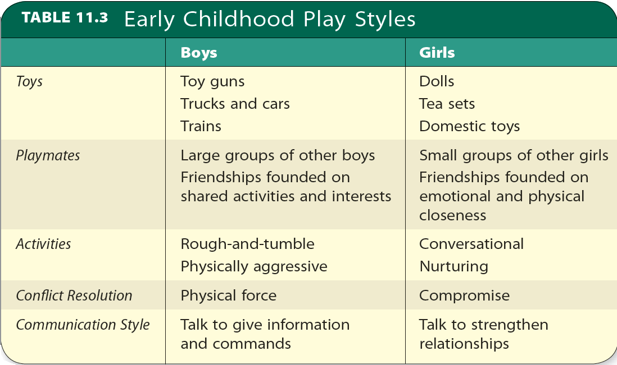
Table 11.3 - Early Childhood Play Styles
Source: Golomobok et al., 2008.

Slide 27
Culture Influences on Play
Cultural values affect the play environments.
Affect the frequency of specific forms of play.

Slide 28
Discipline
Methods of molding children’s character and teaching them to:
Exercise self-control
Engage in acceptable behavior
Includes rewarding desired behaviors and drawing attention to how actions affect others
Powerful tool for socialization with the goal of developing self-discipline

Slide 29
Reinforcement and Punishment
Reinforcement
External reinforcements - Tangible or intangible
Internal reinforcement - Sense of pleasure or accomplishment
Punishment
Effective if it is:
Consistent
Immediate
Clearly tied to the offense
Harsh punishment is regarded as harmful.

Slide 30
Reinforcement and Punishment
Corporal punishment
Psychological aggression
Use of physical force with the intention of causing pain but not injury so as to correct or control behavior
Believed to be more effective
Harmless if done in moderation by loving parents
Discipline becomes abusive when it results in injury to a child.
Verbal attack resulting in psychological harm
Yelling or screaming
Threatening to spank or hit the child
Swearing or cursing at the child
Threatening to send the child away
Calling the child dumb or lazy

Slide 31
Inductive Reasoning, Power Assertion, and Withdrawal of Love
Inductive techniques
Induce desirable behavior by appealing to a child’s sense of reason and fairness.
Power assertion
Discourages undesirable behavior through physical or verbal enforcement of parental control.
Withdrawal of love
Involves ignoring, isolating, or showing dislike for a child.

Slide 32
Prosocial Behavior
Altruism: Motivation to help others without expectation of reward.
May involve self-denial or self-sacrifice
Prosocial behavior: Voluntary behavior intended to help others.
Prosocial disposition may be partly genetic or temperamental.

Slide 33
Aggression
Instrumental aggression: Aggressive behavior used as a means of achieving a goal.
Gender differences in aggression:
Boys - Overt, or direct, aggression: Aggression that is openly directed at its target.
Girls - Relational, or social, aggression: Aggression aimed at damaging or interfering with another person’s relationships, reputation, or psychological well-being.

Slide 34
Influences on Aggression
Genetic and environmental sources
Parental behaviors
Exposure to violence
Electronic media
Culture

Slide 35
Fearfulness
Stems from:
Intense fantasy life
Tendency to confuse appearance with reality
Personal experience
Parents can allay children’s fears by:
Instilling a sense of trust and normal caution without being too protective
Overcoming their own unrealistic fears

Slide 36
Relationships with Other Children
Sibling relationships
Disputes and their settlement viewed as socialization opportunities.
Rivalry is not the main pattern early in life.
Same-sex siblings are closer and play together more peaceably.
Impact relationships with other children.

Slide 37
Relationships with Other Children
Only child
Performs better on academic outcomes and attains success in work
More motivated to achieve and has higher self-esteem
Does not differ in:
Emotional adjustment
Sociability
Popularity

Slide 38
Relationships with Other Children
Playmates and friends
Toddlers play alongside or near each other.
Friendship does not develop until the age of 3.
Preschoolers like to play with children:
Of their own age and sex
Who are similar to them in observable characteristics
Traits that young children look for in a playmate are similar to those in a friend.

Slide 39
Relationships with Other Children
Preschool children prefer prosocial playmates.
Peer relationships are affected by children’s relationships with:
Parents
Siblings
Teachers

