Slide 1
Chapter 10 & 13
Cognitive Development in Early & Middle Childhood

Slide 2
Jean Piaget’s Preoperational Stage 2-7 years old
Notes:
Technology Tip: Show students selected film clips from Kindergarten Cop starring Arnold Schwarzenegger. The movie provides a humorous look at young children and may spark a discussion of real versus stereotype views of early childhood.

Slide 3
Piaget’s Preoperational Stage
Preoperational stage: Piaget’s second stage, lasting from 2 to 7 years of age, during which time children begin to represent the world with words, images, and drawings
Operations: Internalized set of actions; Mental manipulations of concepts and ideas
Stages:
Symbolic Function (Preconceptual) 2-4 years
Intuitive 4-7 years

Slide 4
Piaget’s Preoperational Stage
Symbolic function stage
First substage of preoperational thought
Occurs in ages 2 to 4, imaginative drawings
Ability to mentally represent object not present
Thoughts limited by beliefs:
Egocentrism
Animism

Slide 5
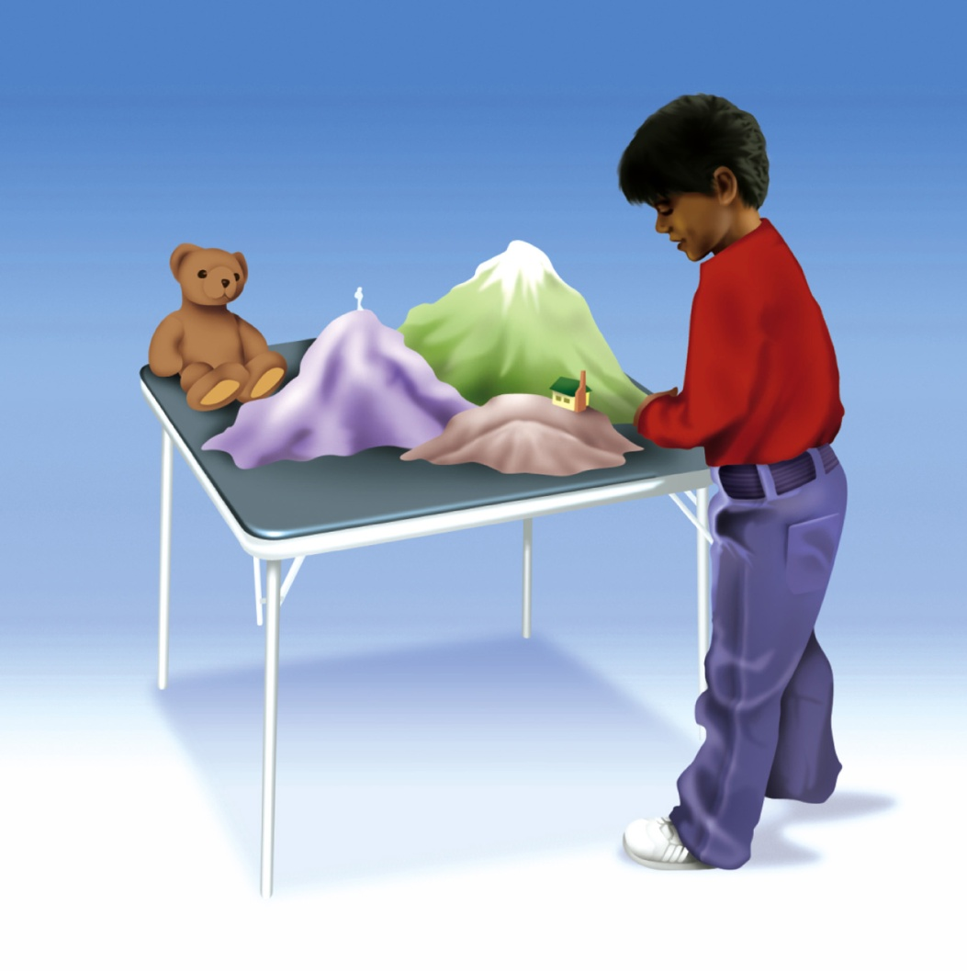
The Three-Mountains Test
Figure 9.1
Notes:
Figure 9.1 The Three-Mountains Test. Piaget used the three-mountains test to learn whether children at certain ages are egocentric or can take the viewpoints of others.

Slide 6
Piaget’s Preoperational Stage
Intuitive thought substage
Uses primitive reasoning, seeks answers to all
Occurs about 4 to 7 years of age
Limits in preoperational thought
Centration
Lack of Conservation
Irreversibility
Lack of Class Inclusion

Slide 7
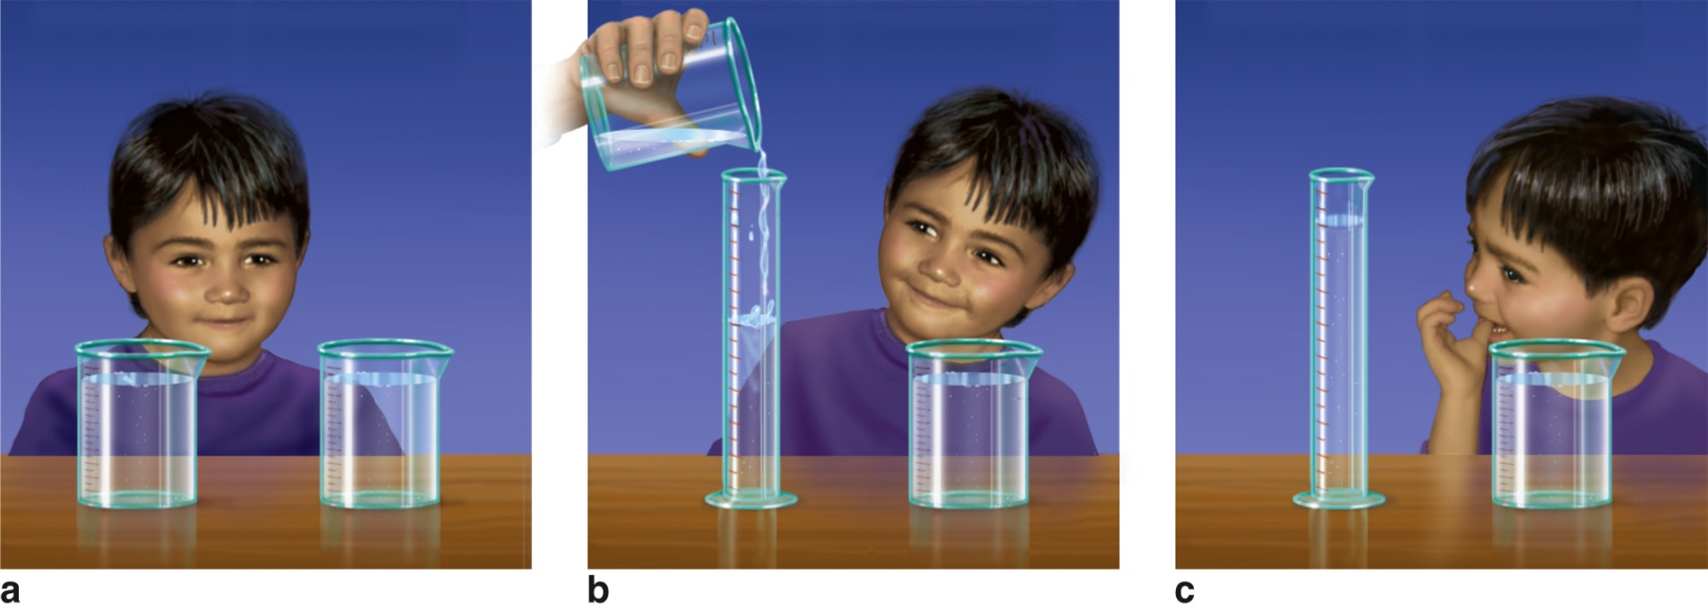
Conservation
Figure 9.2
Notes:
Figure 9.2 Conservation. (a) The boy in this illustration agreed that the amount of water in two identical containers is equal. (b) He then watched as water from one container was poured into a tall, thin container. (c) When asked whether the amounts of water in the two containers are now the same, he says no.

Slide 8
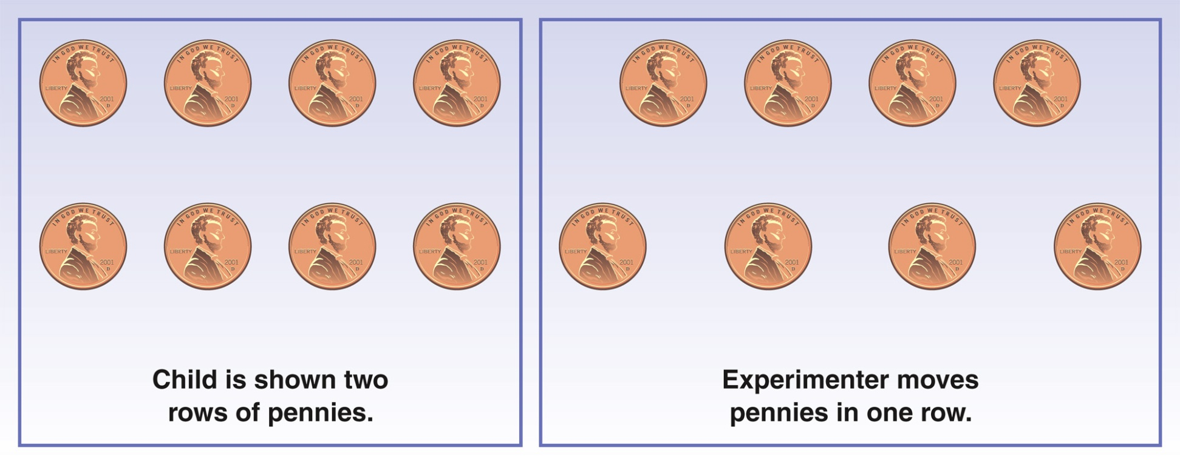
Conservation of Number
Figure 9.3
Notes:
Figure 9.3 Conservation of Number. In this demonstration, we begin with two rows of pennies that are spread out equally, as shown in the left-hand part of the drawing. Then one row of pennies is spread out more, as shown on the right-hand side. We then ask the child, “Do the two rows still have the same number of pennies”? Do you think that a preoperational child will conserve the number of pennies or focus on the length of the longer row in arriving at an answer?

Slide 9
Lack Class Inclusion
Class inclusion means separating things into main classes as well as subclasses.
Requires child focus on more than one aspect of situation at once
Cannot think about two subclasses and the larger class at the same time

Slide 10
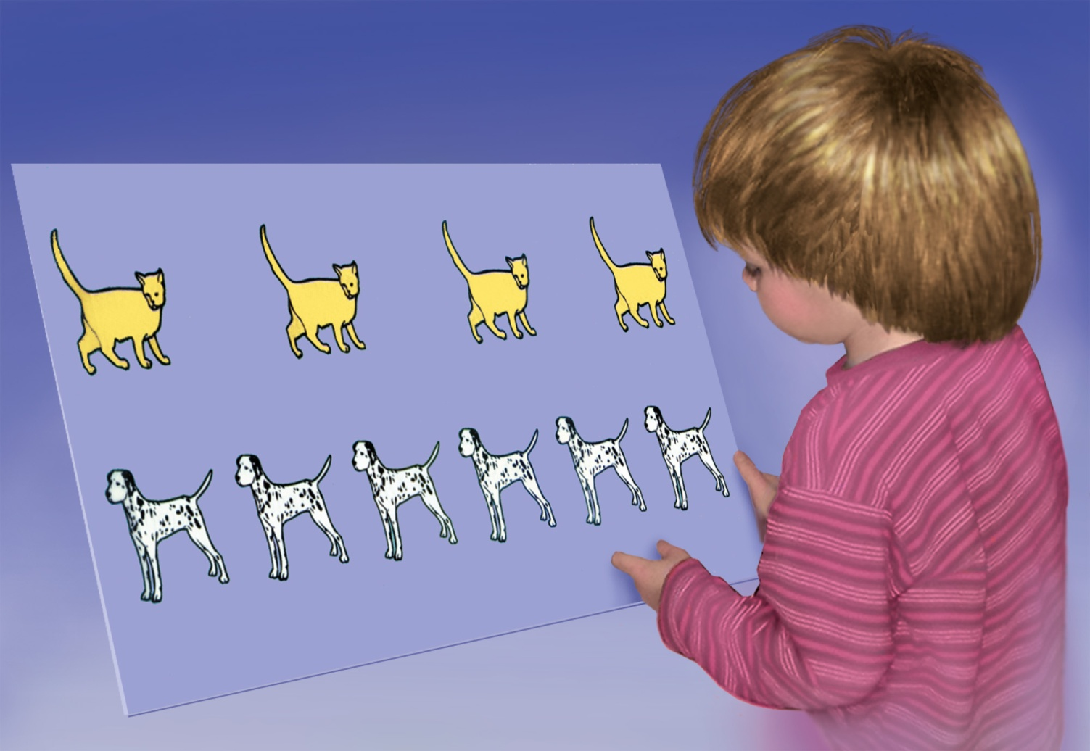
Class Inclusion
Notes:
Figure 9.4 Class Inclusion. A typical 4-year-old child will say that there are more dogs than animals in the example.

Slide 11
Immature Aspects of Preoperational Thought (According to Piaget)
Limitation | Description
Centration | Focusing on one aspect of a situation and neglecting others
Irreversibility | Failing to understand that some operations or actions can be reversed, restoring the original situation
Focus on states rather than on transformations | Failing to understand the significance of the transformation between states
Transductive reasoning | Jumping from one particular reasoning to another and seeing cause where none exists
Egocentrism | Assuming everyone else thinks, perceives, and feels as they do
Animism | Attributing life to inanimate objects
Inability to distinguish appearance from reality | Confusing what is real with outward appearance

Slide 12
Cognitive Advances during Early Childhood
Advance | Significance
Use of symbols | Imagination that objects or people have properties other than those they actually have
Understanding of identities | Awareness that superficial alterations do not change the nature of things
Understanding cause and effect | Realization that events have causes
Ability to classify | Organization of objects, people, and events into meaningful categories
Understanding of numbers | Ability to count and deal with quantities
Empathy | Ability to imagine how others might feel
Theory of mind | Awareness of mental activity and the functioning of the mind

Slide 13
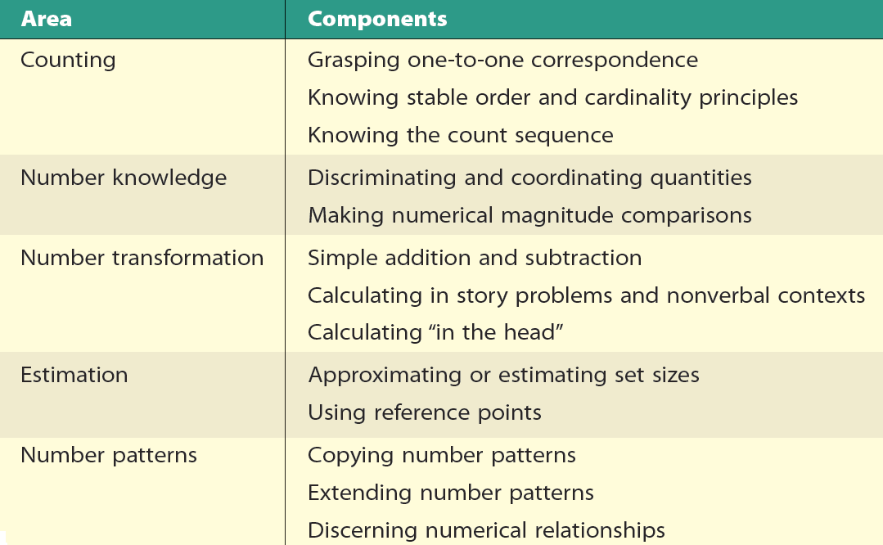
Table 10.3 - Key Elements of Number Sense in Young Children
Source: Adapted from Jordan et al., 2006.

Slide 14
The Concrete Operational Stage 7-12 years old
Notes:
14
Teaching Tip: Ask students to read a variety of magazines, books, or comic strips written for children in this age group. Have students analyze their readings in terms of the type of words, phrases, and grammatical structure used and then share their findings in class. What conclusions can be drawn about language comprehension and its relationship to humor?

Slide 15
Concrete Operational Thought
Gains in abilities
Reversible mental actions applied to real, concrete objects
Focus on several characteristics at once
Conservation skills
Object can have several properties or dimensions
Child can de-center and focus on more than one dimension
Horizontal Decalage

Slide 16
Cognitive Advances
Categorization
Seriation: Ability to order items along a dimension.
Transitive inference: Understanding the relationship between two objects.
By knowing the relationship of each to a third object
Class inclusion: Understanding the relationship between a whole and its parts.

Slide 17
Cognitive Advances
Conservation
Primary achievements in this stage
Principle of identity
Principle of reversibility
Decenter
Horizontal décalage: Inability to transfer learning about one type of conservation to other types.
Causes a child to master different types of conservation tasks at different ages.

Slide 18
Cognitive Advances
Inductive reasoning: Logical reasoning that moves from particular observations about members of a class to a general conclusion about that class.
Deductive reasoning: Logical reasoning that moves from a general premise about a class to a conclusion about a particular member or members of the class.

Slide 19
Cognitive Advances
Number and mathematics
By age 6 or 7 many children can count mentally.
There are different routes toward learning.
Need to be learned in a culture
Intuitive understanding of fractions exists by age 4.
Ability to estimate progresses with age
Number line estimation
Computational estimation
Numerosity estimation
Measurement estimation

Slide 20
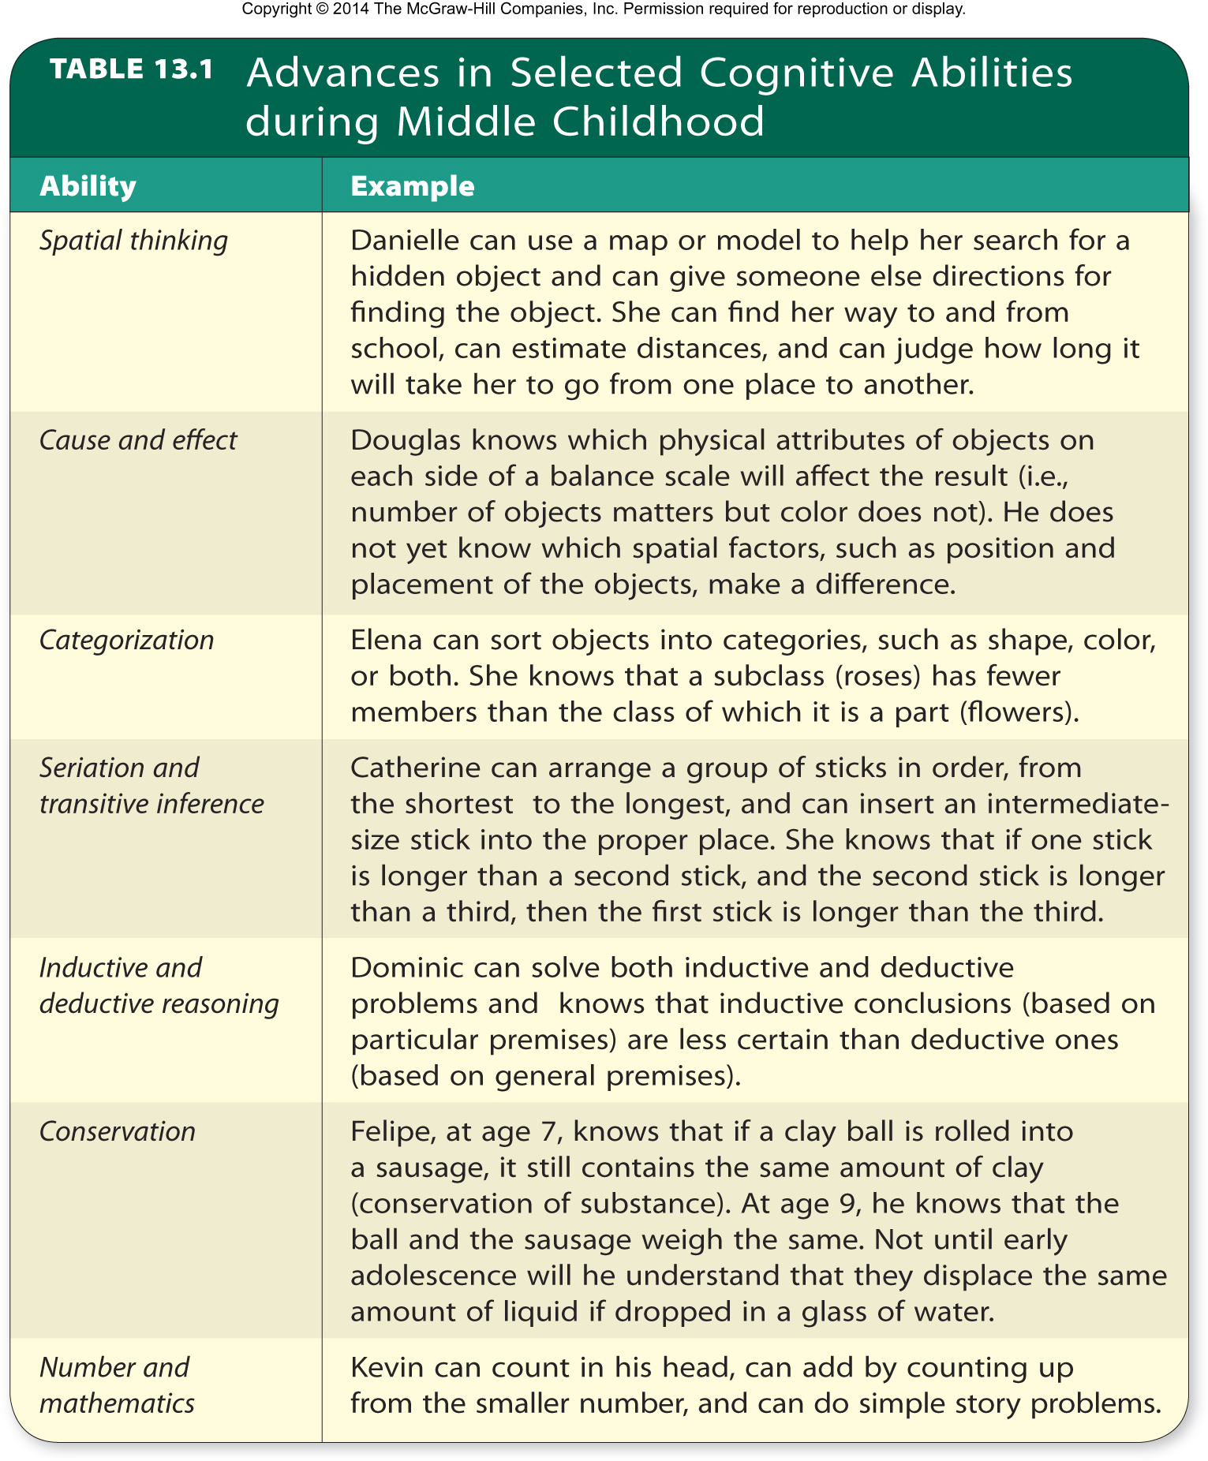

Slide 21
Information Processing Theory
Notes:
21
Teaching Tip: Ask students to read a variety of magazines, books, or comic strips written for children in this age group. Have students analyze their readings in terms of the type of words, phrases, and grammatical structure used and then share their findings in class. What conclusions can be drawn about language comprehension and its relationship to humor?

Slide 22
Information-Processing Approach: Memory Development
Basic processes and capacities
Encoding: Information is prepared for long-term storage and later retrieval.
Storage: Retention of information in memory for future use.
Retrieval: Information is accessed or recalled from memory storage.

Slide 23
Information-Processing Approach: Memory Development
Sensory memory: Initial, brief, temporary storage of sensory information.
Working memory: Short-term storage of information being actively processed.
Long-term memory: Storage of virtually unlimited capacity that holds information for long periods of time
Executive function: Conscious control of thoughts, emotions, and actions to accomplish goals or solve problems. Changes occur between 2 and 5.

Slide 24
Information-Processing Approach: Attention, Memory, and Planning
Executive functioning develops:
Gradually from infancy to adolescence
Accompanied by brain development, most notably in the prefrontal cortex
By environmental influences
By parenting practices and culture
Affect the pace at which children are given the opportunity to practice executive functioning skills

Slide 25
Information-Processing Approach: Memory Development
Forming and retaining childhood memories: Three types of memories.
Generic memory: Produces scripts of familiar routines to guide behavior. (age 2)
Episodic memory: Long-term memory of specific experiences or events, linked to time and place.
Autobiographical memory: Type of episodic memory of distinctive experiences that form a person’s life history. (age 3-4)

Slide 26
Information-Processing Approach: Memory Development
Influences on memory retention:
Uniqueness of the event
Events with emotional impact
Central aspects remembered best
Active participation
Social interaction model: Proposes that children construct autobiographical memories through conversation with adults about shared events.

Slide 27
Memory in Early Childhood
Best for meaningful and familiar events
As young as 11 months remember sequences just experienced
16 months can reenact sequence after delay of 6 weeks
By 4 years, can remember events up to 18 months earlier
Less likely than older children to reject false suggestions about events
STM
Increases from 2 digits at 2 years old to 5 digits for 7 year old
Better able to transfer information to LTM
More room to process information
Speed increases
Notes:
Truth or Fiction Revisited
One- and 2-year-olds are too young to remember past events. (FALSE)
Teaching Tip: Social Work & Counseling: Have students find out more about memory of traumatic events, particularly early abuse. What does research say about the validity of such memories? How does this relate to information in the text?
Teaching Tip: Parenting & Family Studies: Have students compare and contrast different types of autobiographical memories they have of their early years. What age were they at the time of those memories? Do other family members share these memories? Students should categorize these memories (e.g. related to an intense emotion).

Slide 28
Theory of Mind
The Child’s Theory of Mind
Awareness of mental processes of self, others
Ages 18 months to 3 years, child understands three mental states are related to behavior
Perceptions
Emotions
Desires
Ages 3-5: Realizes thinking goes on in the mind and that there are ‘false beliefs’
Ages 5-7: Deeper appreciation of mind itself

Slide 29
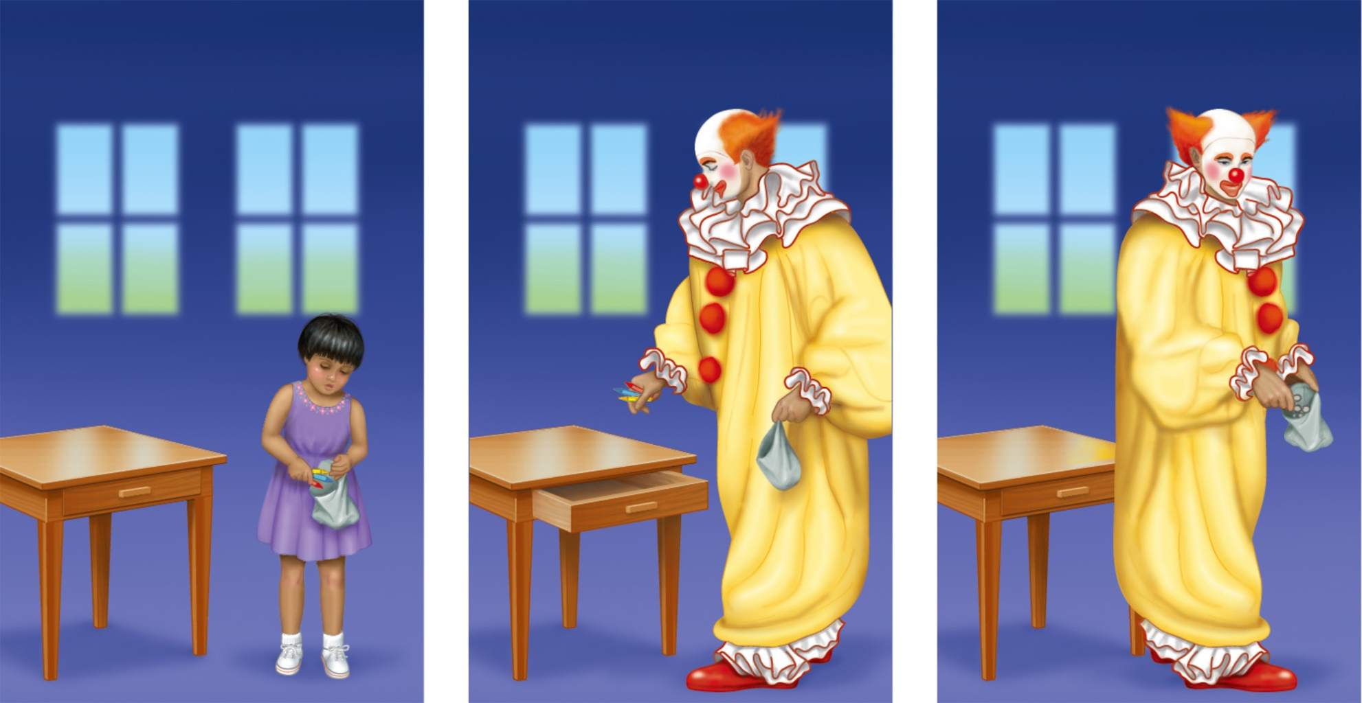
False Beliefs
Figure 9.5
Notes:
Figure 9.5 False Beliefs. John Flavell and his colleagues showed preschoolers a videotape in which a girl named Cathy found crayons in a bag (a). When Cathy left the room, a clown entered, removed the crayons from the bag, hid them in a drawer (b), and filled the bag with rocks. (c). When asked whether Cathy thought there would be rocks or crayons in the bag, most 3-year-olds said “rocks.” Most 4-year-olds correctly answered “crayons,” showing the ability to separate their own beliefs from someone who has erroneous knowledge of a situation.

Slide 30
Theory of Mind
The Child’s Theory of Mind
Ages 5-6: knows different experiences exist
Age 7: realizes knowledge is subjective
Theory focuses on preschool years to age 7
Individual differences include: number of siblings, disabilities, parental interactions
Important developments occur after age 7

Slide 31
Theory of Mind
Reflects brain maturation and general improvements in cognition.
Social competence and language development contribute to an understanding of thoughts and emotions.
Pretend play stimulates the development of theory-of-mind skills.
Incomplete or ineffective theory of mind may be a sign of a cognitive or developmental impairment.

Slide 32
Information-Processing Approach: Attention, Memory, and Planning
Selective attention
Ability to deliberately direct one’s attention and shut out distractions.
Inhibitory control - Voluntary suppression of unwanted responses.
Metamemory
Understanding of processes of memory.
13-32

Slide 33
Information-Processing Approach: Attention, Memory, and Planning
Memory Aides
External memory aids: Using something outside the person.
Rehearsal: Keeping an item in working memory through conscious repetition.
Organization: Categorizing material to be remembered.
Elaboration: Making mental associations involving items to be remembered.
Mnemonics: Strategy to aid memory.

Slide 34
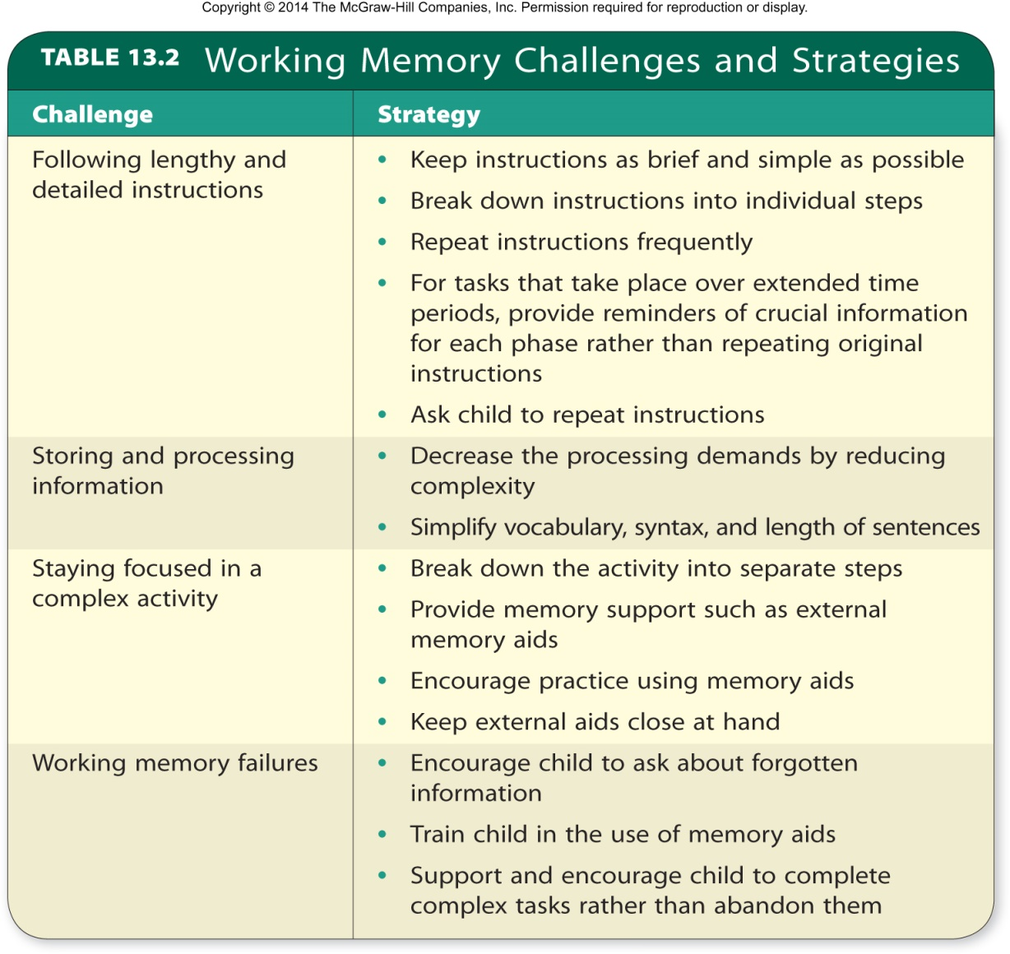
Table 13.2 - Working Memory Challenges and Strategies

Slide 35
Testing and Teaching Based on Vygotsky’s Theory
Zone of proximal development (ZPD): Difference between what a child can do alone and what the child can do with help.
Assessed by dynamic tests
Scaffolding: Temporary support to help a child master a task.
Provided by a sophisticated interaction partner

Slide 36
Traditional Psychometric Measures
Stanford-Binet Intelligence Scale
Used to measure:
Knowledge
Quantitative reasoning
Visual-spatial processing
Working memory
Wechsler Preschool and Primary Scale of Intelligence, Revised (WPPSI-III)
Yields verbal and performance scores as well as a combined score

Slide 37
Psychometric Approach: Assessment of Intelligence
Wechsler Intelligence Scale for Children (WISC-III)
Otis-Lennon School Ability Test (OLSAT8)
Individual intelligence test for schoolchildren that yields verbal and performance scores as well as a combined score.
Group intelligence test for kindergarten through 12th grade.

Slide 38
IQ Controversy
Pros
Cons
Standardized and widely used
Extensive information about:
Norms
Validity
Reliability
Fairly good predictors of school achievement.
Underestimates the intelligence of children who do not do well on tests.
Equates intelligence with speed and penalizes a child who works slowly.
Infers intelligence from what children already know.

Slide 39
Influences on Intelligence
Genes and brain development
Pattern of development of prefrontal cortex is the key to differences in IQ .
Other brain regions under strong genetic influence contribute to intelligent behavior.
Schooling
Seems to increase IQ scores
Scores drop during summer vacation.

Slide 40
Influences on Intelligence
Race/ethnicity
No direct evidence supports differences in intelligence among ethnic, cultural, or racial groups are hereditary.
Differences in IQ attributed to inequalities in environment.

Slide 41
Influences on Intelligence
Culture
Test of intelligence developed in one culture may not be equally valid in another.
Culture-free test: Intelligence test, if possible to design, that would have no culturally linked content.
Culture-fair test: Intelligence test that deals with experiences common to various cultures.
Attempt to avoid cultural bias

Slide 42
Gardner’s Theory of Multiple Intelligences
There are eight distinct forms of intelligence.
High intelligence in one area does not necessarily accompany high intelligence in any of the others.

Slide 43
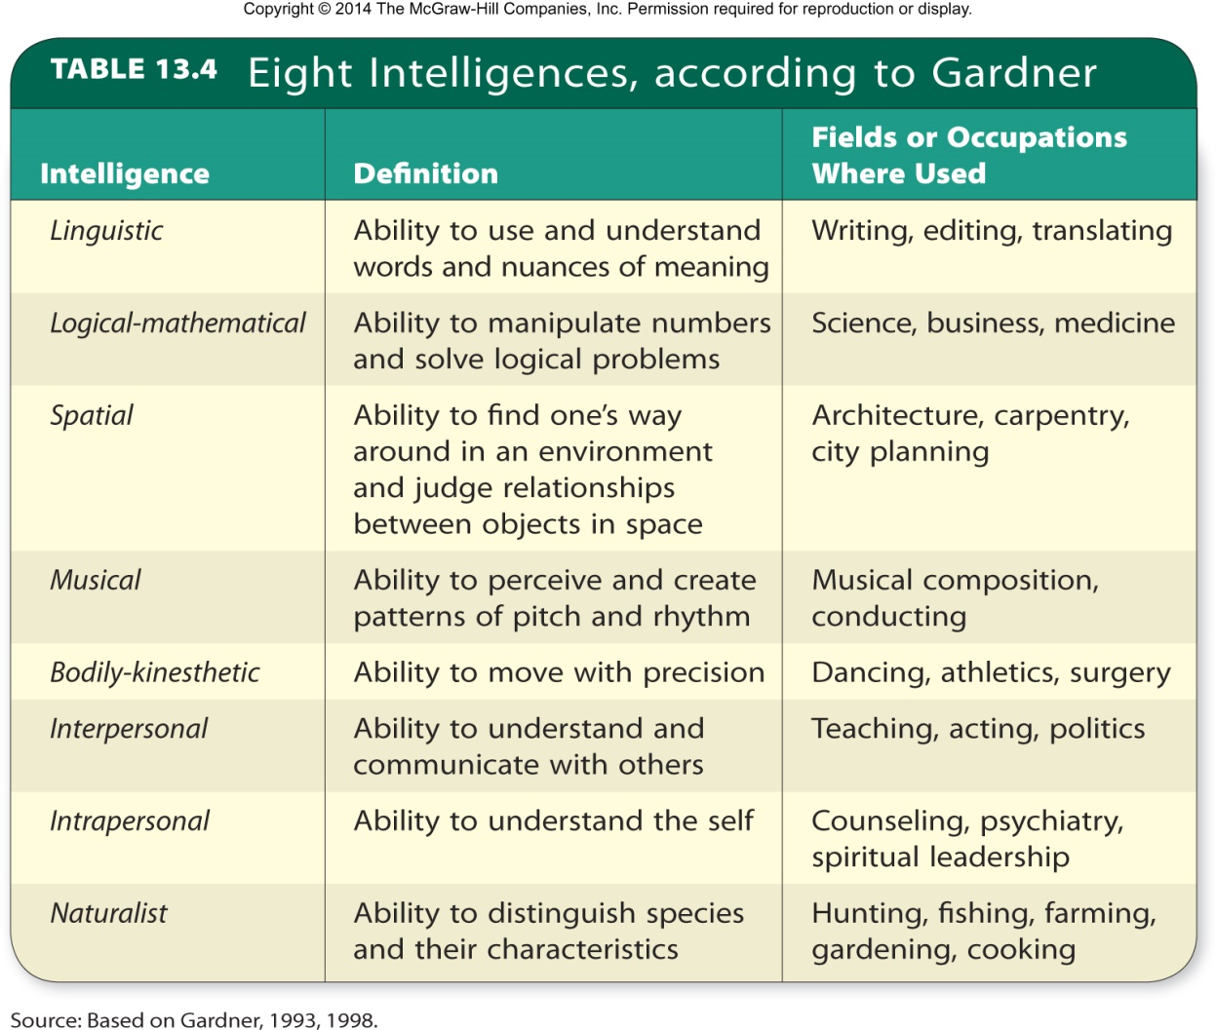
Table 13.4 - Eight Intelligences, According to Gardner

Slide 44
Sternberg’s Triarchic Theory of Intelligence
Intelligence consists of three elements:
Componential element: Analytic aspect of intelligence
Determines how efficiently people process information
Experiential element: Insightful aspect of intelligence
Determines how people approach novel or familiar tasks
Contextual element: Practical aspect of intelligence
Determines how people deal with their environment

Slide 45
Sternberg’s Triarchic Theory of Intelligence
Focused on processes that predicted intelligent behavior across domains of knowledge
Verbal
Quantitative
Figural
Tacit knowledge: Information that is not formally taught or openly expressed, but is necessary to get ahead.

Slide 46
Other Directions in Intelligence Testing
Kaufman Assessment Battery for Children (K-ABC-II): Nontraditional individual intelligence test designed to provide fair assessments of:
Minority children
Children with disabilities
Dynamic tests: Based on Vygotsky’s theory that emphasizes potential rather than past learning.

