Slide 1
Adolescence

Slide 2
Adolescence: A Developmental Transition
Adolescence: Developmental transition between childhood and adulthood entailing major changes.
Physical
Cognitive
Psychosocial
Puberty: Process by which a person attains sexual maturity and the ability to reproduce.

Slide 3
Adolescence
Not a clearly defined physical or biological category
Lasts longer and less clear cut as in the past because:
Puberty begins earlier
Additional years of higher education

Slide 4
Adolescence: Opportunities and Risks
Opportunities
Risks
Physical growth
Cognitive and social competence
Autonomy and self-esteem
Intimacy
High death rates from:
Accidents
Homicide
Suicide
Tendency to engage in risky behaviors

Slide 5
Puberty
Begins from a cascade of hormonal responses
1. Adrenarche - Activation of the adrenal glands.
Occurs between ages 6 and 8
Increased levels of androgens, most notably dehydroepiandrosterone (DHEA)
Influences the growth of pubic, axillary, and facial hair
Contributes to faster body growth, oilier skin, and development of body odor

Slide 6
Puberty
2. Gonadarche - Sex organ maturity.
Second burst of DHEA
Girls - Ovaries increase their input of estrogen.
Stimulates the growth of female genitals
Development of breast and pubic and underarm hair
Boys - Testes increase the production of androgens, especially testosterone.
Growth of male genitals, muscle mass, and body hair

Slide 7
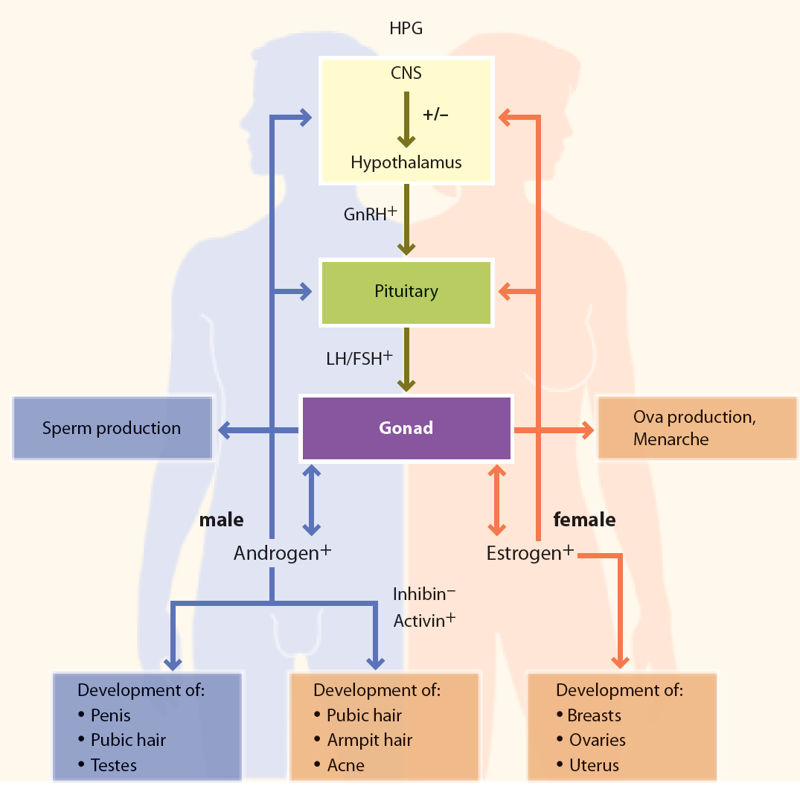
Figure 15.1- Regulation of Human Puberty Onset and Progression

Slide 8
Adolescent Growth Spurt
Sharp increase in height and weight that precedes sexual maturity
Lasts about 2 years
Girls - Between ages 9 ½ and 14
Boys - Between ages 10 ½ and 16

Slide 9
Primary and Secondary Sex Characteristics
Changes include:
Primary sex characteristics: Organs directly related to reproduction enlarge and mature during adolescence.
Secondary sex characteristics: Physiological signs of sexual maturation that do not involve the sex organs.

Slide 10
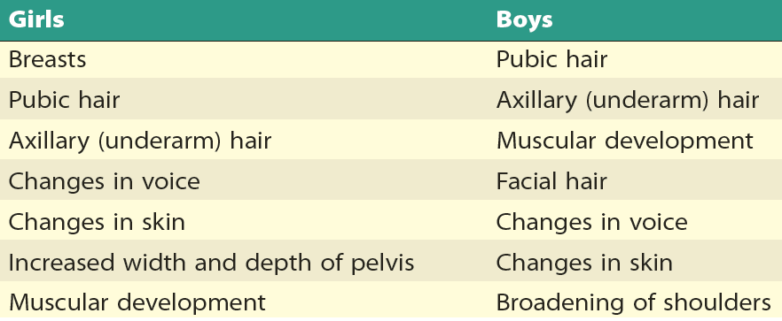
Table 15.2 - Secondary Sex Characteristics

Slide 11
Signs of Sexual Maturity
Primary Sex Characteristic
Spermarche: Production of viable sperm or Boy’s first ejaculation.
Nocturnal emission - Involuntary ejaculation of semen.
Menarche: Girl’s first menstruation.
Menstruation - Monthly shedding of tissue from the lining of the womb.

Slide 12
Influences on Timing of Puberty
Secular trend: Trend that can be seen only by observing several generations.
Higher standard of living
Combination of genetic, physical, emotional, and contextual influences
Pheromones - Odorous chemicals that attract mates.
May delay or accelerate puberty
Individual Timing influences adolescents’ behavior and self-esteem.

Slide 13
Implications of Early and Late Maturation
Boys
Girls
Early maturation
Increased self-esteem but difficulty in meeting expectations
Late maturation - Leads to feeling:
Inadequate
Self-conscious
Rejected
Dominated
Like to mature at the same time as their peers
Early maturation makes girls:
Less sociable
Less expressive
Less poised
More introverted, shy, and negative

Slide 14
Gender
Gender identity: Awareness that one is male or female.
Develops in early childhood
Gender roles: Behaviors, interests, attitudes, skills, and traits that a culture considers appropriate.
Gender-typing: Socialization process whereby children learn appropriate gender roles.
Gender stereotypes: Preconceived generalizations about male or female role behavior.

Slide 15
Gender
Development
2 to 2 1/2 years – accurate identifying of pictures of boys and girls
3 years – display knowledge of gender stereotypes
Traditional stereotypes about activities, occupations, personality traits
View their own gender more positively
Stereotyping may be at highest around age 5
Older children become more flexible
Recognize individual differences

Slide 16
Gender
Physiological Gender
Chromosomal Gender
Gonadal Gender
Hormonal Gender
Genital Gender

Slide 17
Five Perspectives on Gender Development
Theories | Major Theorists | Key Processes | Basic Beliefs
Biological Approach |  | Genetic, neurological, and hormonal activity | Behavioral differences between the sexes can be traced to biological differences.
Evolutionary Developmental Approach | Charles Darwin | Natural sexual selection | Children develop gender roles in preparation for adult mating and reproductive behavior.

Slide 18
Five Perspectives on Gender Development
Theories | Major Theorists | Key Processes | Basic Beliefs
Psychoanalytic Approach Psychosexual theory | Sigmund Freud | Resolution of unconscious emotional conflict | Gender identity occurs when child identifies with same-sex parent.
Cognitive Approach Cognitive-developmental theory | Lawrence Kohlberg | Self-categorization | Once a child learns she is a girl or he is a boy, child sorts information about behavior by gender and acts accordingly.

Slide 19
Five Perspectives on Gender Development
Theories | Major Theorists | Key Processes | Basic Beliefs
Gender-schema theory | Sandra Bem, Carol Lynn Martin, & Charles F. Halverson | Self-categorization based on processing of cultural information | Child gathers culture specific information on genders and acts accordingly.
Social Learning Approach Social cognitive theory | Albert Bandura | Observation of models, reinforcement | Child mentally combines observations of multiple models and creates own behavioral variations.

Slide 20
Origins of Sexual Orientation
Sexual orientation: Focus of consistent sexual, romantic, and affectionate interest.
Either heterosexual, homosexual, or bisexual
No association between homosexual orientation and emotional or social problems.
Partly genetic
Imaging studies - Similarities of brain structure and function between homosexuals and heterosexuals of the other sex.

Slide 21
Developing A Sexual Identity
Adolescence is time of:
Ambivalence; sex used in movies/videos/TV shows/music
Frequent viewing tied to casual sex attitudes
Mastering sexual feelings and forming sense of sexual identity is lengthy, multifaceted
Gay and lesbian youth have diverse patterns of initial attraction, often bisexual

Slide 22
Timing and Trends
Timing of sexual initiation varies by:
Country, gender, other socioeconomic factors
In U.S.
African American males and inner-city adolescents are most sexually active
Asian American adolescents have most restrictive sexual timetable

Slide 23
Timing and Trends
Currently in U.S.
Over 60% of 12th graders; over 30% of 9th graders have had sex
Dramatic increase in oral sex during adolescence
55% of male adolescents, aged 15 to 19
54% of females, aged 15 to 19
Affected by heavy drinking, having sexually active friends, and approving friends

Slide 24
Sexual Risk Taking in Adolescence
Sexually active teens under 16
Ineffective users of contraceptives
At risk for teen pregnancy and STDs
Linked to alcohol and drug use, low academic achievement, and earlier age for sexual initiation
Linked to early adolescent sex problems
SES, family/parenting and peer factors
Low self-esteem, extensive TV watching

Slide 25
Sexual Risk Taking in Adolescence
Cognitive factors in sexual risk taking
Attention problems
Multiple school problems, antisocial behavior, substance use in middle school
Self-regulation (emotions and behaviors)
Contraceptive use
Adolescents: substantial increase in use
Many still do not use contraceptives
Older teens more likely to reduce risks

Slide 26
Sexual Risk Taking in Adolescence
Sexually transmitted infections
Contracted through bodily fluid contact
About 25% of ‘active’ teens infected each year
Bacterial infections (syphilis, chlamydia)
Viral infections (genital herpes, AIDS, etc.)
AIDS destroys body’s immune system
15% in U.S. were 13 to 24 years of age
Devastating sub-Saharan African countries
Some infections from needles of drug users

Slide 27
Sexual Risk Taking in Adolescence
Adolescent pregnancy
U.S. rates declining; still one of highest in industrialized world
Reasons for decreasing:
Fear of STIs, especially AIDS
School, community awareness classes
Greater hope for future
Latina teens at most risk of teen pregnancy

Slide 29
Sexual Risk Taking in Adolescence
Cross-cultural comparisons of adolescent pregnancy
Three reasons why U.S. rates so high
Childbearing viewed as adult activity
Other countries encourage teens to wait, but teen sexual expression more accepted
Access to family planning services
U.S. expectations and attitudes more lax, yet access to planning services more restricted

Slide 30
Sexual Risk Taking in Adolescence
Adolescent pregnancy has risks
Low-birthweight infants more likely; linked to infant mortality, neurological and health issues
Young mothers quit school, have less earning power, fewer economic resources available
Low SES teens have higher risk
More likely female child born to teen mother will perpetuate intergenerational cycle
Teen moms may do low parental monitoring

Slide 31
The Adolescent Brain
Rapid and profound development
Corpus callosum
Fibers connect hemispheres of the brain; thickening
Prefrontal cortex
Reasoning; finishes maturing in adult years
Amygdala
Seat of emotions; matures early but adolescent does not have total self-control ability

Slide 32
The Adolescent Brain
Not completely mature
Risk-taking results from the interaction of following brain networks:
Socioemotional network
Sensitive to social and emotional stimuli
Cognitive-control network
Regulates responses to stimuli
Adolescents’ choices are based on emotions.
Result of changes in grey and white matter in amygdala and prefrontal cortex

Slide 33
Piaget’s Stage of Formal Operations
Formal operations: Highest level of cognitive development, characterized by ability to think abstractly.
Capacity for abstract thought
Use symbols for symbols
Appreciate hidden messages in metaphors
Think about what might be, not just what is
Form and test hypotheses

Slide 34
Piaget’s Stage of Formal Operations
Hypothetical-deductive reasoning: Ability, believed by Piaget to accompany the stage of formal operations, to develop, consider, and test hypotheses.
Factors that bring about shift to formal operations
Brain maturation
Expanding environmental opportunities
Schooling and culture

Slide 35
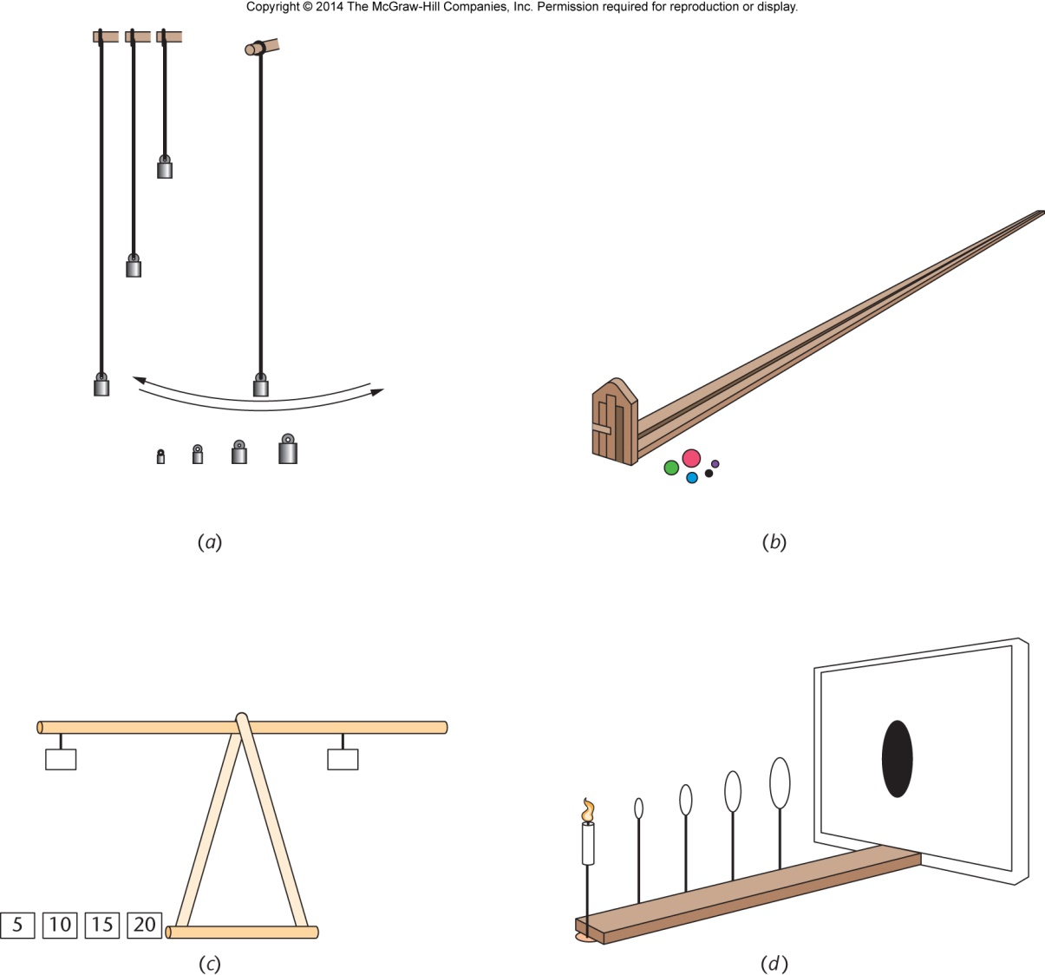
Figure 16.1 - Piagetian Tasks for Measuring Attainment of Formal Operations

Slide 36
Elkind: Immature Characteristics of Adolescent Thought
Idealism and criticalness – Ultra-conscious of hypocrisy.
Argumentativeness - Opportunities to try out reasoning abilities.
Indecisiveness - Struggling with simple decisions.
Apparent hypocrisy
Cannot differentiate between expressing an ideal and making sacrifices to live up to it.

Slide 37
Elkind: Immature Characteristics of Adolescent Thought
Self-consciousness
Imaginary audience: Conceptualized observer who is as concerned with a young person’s thoughts and behavior as he or she is.
Specialness and invulnerability
Personal fable: Conviction that one is special, unique, not subject to rules that govern rest of the world.

Slide 38
Use and Abuse of Drugs
Substance abuse: Repeated, harmful use of a substance.
Alcohol
Other drugs
Substance dependence: Addiction to a harmful substance.
Physical
Psychological

Slide 39
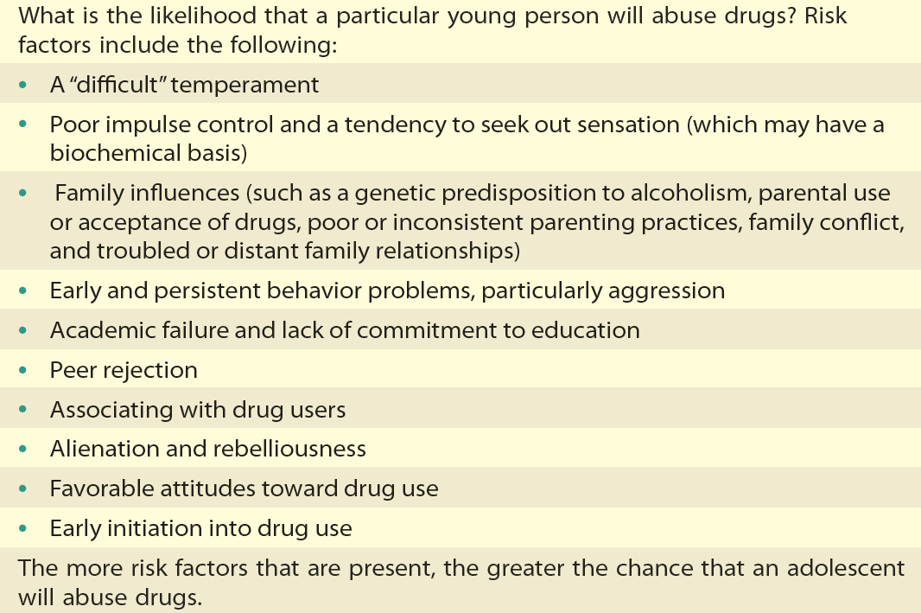
Table 15.4 - Risk Factors for Teenage Drug Abuse
Sources: Hawkins, Catalano, & Miller, 1992; Johnson, Hoff mann, & Gerstein, 1996; Masse & Tremblay, 1997; Wong et al., 2006.

Slide 40
Alcohol Abuse
Alcohol - Potent, mind-altering drug with effects that are:
Physical
Emotional
Social
Binge drinking: Consuming five or more drinks on one occasion.

Slide 41
Marijuana Abuse
Marijuana - Most widely used illicit drug in the United States.
Has been associated with behaviors that meet the criteria for substance dependence:
Tolerance
Withdrawal symptoms
Using a drug even in the presence of adverse effects
Giving up social, occupational, or recreational activities because of substance use

Slide 42
Tobacco Abuse
Tobacco - Use has declined by one-third to one-half since mid-1990s.
Less widespread problem in the United States
Nicotine replacement therapy in concert with behavioral skills training can be effective.

Slide 43
Depression
Prevalence increases during adolescence.
Risk factors
Female gender
Anxiety and fear of social contact
Stressful life events or chronic illnesses
Parent-child conflict, abuse or neglect
Alcohol, drug use, and sexual activity
Parent with a history of depression

Slide 44
Depression
Hospitalization required in case of:
Nonresponsive outpatient treatment
Substance dependence
Psychosis
Suicidal tendency
Other treatments:
Selective serotonin reuptake inhibitors
Psychotherapy

Slide 45
Death in Adolescence
From injuries
Motor vehicle collisions
Firearm-related deaths
Ease of obtaining a gun
Suicide
Emotional illness
Individuals who attempt or commit suicide are likely to be either perpetrators or victims of violence.

Slide 46
Protective Factors: Health in Context
Health and well-being depends on:
Perceptions of connectedness to others
Ability of parents to spending time with and being available
Sense that parents and teachers are warm and caring
Emotional support at home increases the chances of avoiding the health hazards of adolescence.

